Slide 1
LCSH vs. LCGFT Form/Genre Terms
LCGFT is strictly limited (with a few exceptions that may eventually go away) to terms describing genre, form, or genre and form combined
Quotations Poetry Fiction Symphonies Maps
Horror films Epic poetry Fantasy fiction Rock music Topographic maps
LCSH genre/form terms may include other characteristics, including:
creator characteristics such as ethnicity, nationality, religion, gender, sexual orientation, occupation, language, social status, age, etc.
Quotations, American Arabic poetry Fantasy fiction--Women authors
Gays’ writings Gays’ writings, Irish Folk songs, Korean
Catholic fiction Librarians' writings, Swiss (French) Older people’s writings
American poetry--Asian American authors Music by Jewish composers
Notes:
In the following slides, I’ve color coded the LCSH terms as follows:
red: genre/form
blue: creator/contributor characteristics
green: audience characteristics
brown: time period of creation
gray: subject
purple: medium of performance

Slide 2
LCSH vs. LCGFT Form/Genre Terms
LCSH genre/form terms may include other characteristics, including:
intended audience
Children's songs Young adult fiction Men’s magazines
Women's periodicals Blind, Poetry for the Cats--Juvenile poetry
English language--Conversation and phrase books (for flight attendants)
Astronomy--Dictionaries, Juvenile Sex instruction for teenagers
Spanish language--Sound recordings for English speakers
time period of creation
Literature, Medieval Operas--18th century Anatomy--Early works to 1800
Music--15th century Law--Bibliography--Early Early maps
European drama--Renaissance, 1450-1600 Rock music--2011-2020
Notes:
ǂv Bibliography ǂv Early
Use as a form subdivision under subjects for bibliographies compiled or issued before 1800.
In the slide, I’ve color coded the LCSH terms as follows:
red: genre/form
blue: creator/contributor characteristics
green: audience characteristics
brown: time period of creation
gray: subject
purple: medium of performance

Slide 3
LCSH vs. LCGFT Form/Genre Terms
LCSH genre/form terms may include other characteristics, including:
medium of performance
Concertos (Cello) Marches (Flute and piano) Chaconnes (Tuba and piano) Guitar music Overtures (Flute, guitar, viola) Clarinet music (Jazz)
combinations of characteristics
Children's stories, American Christian drama, Latin (Medieval and modern)
Greek literature, Modern--1453-1800 Piano music--Juvenile
Young adult fiction, Philippine (English) Rock music--Iceland--2001-2010
Notes:
In the slide, I’ve color coded the LCSH terms as follows:
red: genre/form
blue: creator/contributor characteristics
green: audience characteristics
brown: time period of creation
gray: subject
purple: medium of performance

Slide 4
LCGFT and Other Characteristics
What happens when 650 is only used for terms representing what something is about? That is, what happens to the other important characteristics that can’t go in 650 or 655? For example, consider:
650 _0 American poetry $x Women authors.
650 _0 American poetry $x African American authors.
650 _0 American poetry $y 20th century.
The above three subjects would currently be assigned to an anthology of 20th century poetry by African American women. The genre/form is Poetry. Since the work isn’t about 20th century African American women’s poetry, if we stop using 650, and 655 only holds the genre/form, where do we put the information that the creators are American, African American, Women and that the works were created in the 20th century?

Slide 5
Other Characteristics Related to Genre/Form
Audience Characteristics – various fields including new 385
Creator/Contributor Characteristics – various fields including new 386
Language – fixed field Lang (008/35-37), 041, 546, 600-651
Time Period of Creation – 046 $k/$l and $o/$p, and new 388 (not yet implemented in OCLC)
Place of Creation/Origin – new 370 (not yet implemented in OCLC), 751
Medium of Performance – 382
Notes:
We will look in more detail at the first two of these on the slide. Ann will talk about the 382 field.

Slide 6
MARC 385 – Audience Characteristics
Indicators both blank
Subfields:
$a – Audience term (R)
$b – Audience code (R)
$m – Demographic group term (NR)
$n – Demographic group code (NR)
$2 – Source (NR)
$3 – Materials specified (NR)
$0 – Authority record control number or standard number (R)
Notes:
Field Definition and Scope
A category of persons for which a resource is intended or a category of persons representing the intellectual level for which the content of a resource is considered appropriate.
If a demographic group is not specified then multiple audience characteristics from the same source vocabulary or code list may be recorded in the same field in separate occurrences of subfield $a and subfield $b. If a demographic group is specified then the characteristics in the field must all come from the same group. Terms from different source vocabularies are recorded in separate occurrences of the field.

Slide 7
MARC 386 – Creator/Contributor Characteristics
Indicators both blank
Subfields:
$a – Creator/contributor term (R)
$b – Creator/contributor term code (R)
$m – Demographic group term (NR)
$n – Demographic group code (NR)
$2 – Source (NR)
$3 – Materials specified (NR)
$0 – Authority record control number or standard number (R)
Notes:
Field Definition and Scope
A group category to which the creator(s) of a work or compilation of works, or the contributor(s) to an expression or compilation of expressions, belongs.
If a demographic group is not specified then multiple creator/contributor group categories from the same source vocabulary or code list may be recorded in the same field in separate occurrences of subfield $a and subfield $b. If a demographic group is specified then the categories in the field must all come from the same group. Terms from different source vocabularies are recorded in separate occurrences of the field.

Slide 8
MARC 385/386 $m and $n
$m – Demographic group term (NR)
$n – Demographic group code (NR)
During the development of the 385 and 386 fields, some commented that many class of persons headings belong to broader group categories that users might want to search or limit by. For example, children, tweens, teenagers, young adults, middle-aged persons, and senior citizens are all examples of age groups. Catholics, Baptists, Jews, Buddhists, Mormons, Muslims, Hindus, and Wiccans are all examples of religious groups.
Case study: a user might seek works aimed at a religious audience, but the specific religion is not important to them. In this case, it would be nice to be able to code that a work is for a religious audience regardless of the actual religion.
$m and $n were added to the final proposals to accommodate this information. The SAC Genre/Form Implementation Subcommittee came up with an initial list of group categories. LC PSD agreed to maintain the list.

Slide 9
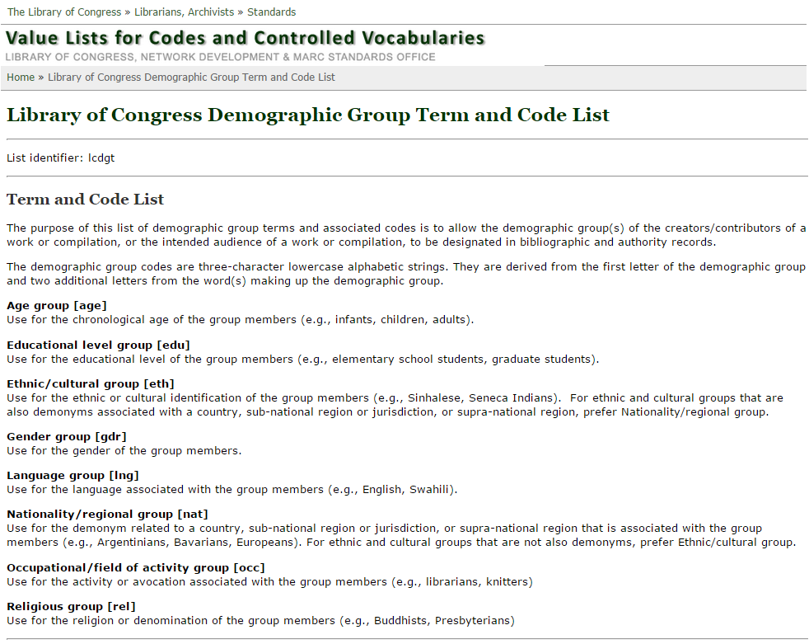
http://www.loc.gov/standards/valuelist/lcdgt.html
Notes:
These are the terms and codes that currently may be used in subfields $m and $n of fields 385 and 386.
The SAC Subcommittee on Genre/Form Implementation initially identified the categories of demographic groups shown in the slide, along with several others that LC has not yet added to the list: Disability group (e.g., Amputees; Deaf); Sexual orientation group (e.g., Bisexuals; Gays; Heterosexuals; Lesbians); Social group (e.g., Gang members; Homeless students; Immigrants; Low-income parents)

Slide 10
385/386 Fields
$m or $n are optional
$2 is optional, but recommended if terms recorded are from a controlled vocabulary
Repeat $a when terms are from the same vocabulary:
386 __ Women $a Canadians $a Librarians $a Archivists $2 lcsh
A work or works created by Canadian women librarians and archivists
Repeat field if $m or $n is used and terms belong to different demographic categories:
386 __ $n gdr $a Women $2 lcsh
386 __ $n nat $a Canadians $2 lcsh
386 __ $n occ $a Librarians $a Archivists $2 lcsh

Slide 11
385/386 Fields
Repeat field if terms are from different controlled vocabularies:
385 __ $n age $a Teenagers $2 lcsh
385 __ $n age $a Adolescents $2 ericd
A work or works for teenagers
386 __ $n eth $a Indians, North American $2 mesh
386 __ $n eth $a American Indians $2 ericd
386 __ $n eth $a Indians of North America $2 lcsh
A work or works created by Native Americans

Slide 12
385/386 Fields
Generally, break up compound terms into their components. For example:
386 __ African American women librarians $2 lcsh
use instead:
386 __ African Americans $a Women $a Librarians $2 lcsh
or
386 __ $n eth $a African Americans $2 lcsh
386 __ $n gdr $a Women $2 lcsh
386 __ $n occ $a Librarians $2 lcsh
A work or works created by African American women librarians

Slide 13
Which Vocabularies to Use?
Any vocabularies that are on the Subject Heading and Term Source Codes list or other appropriate specialized lists such as Occupation Term Source Codes
http://www.loc.gov/standards/sourcelist/subject.html

Slide 14
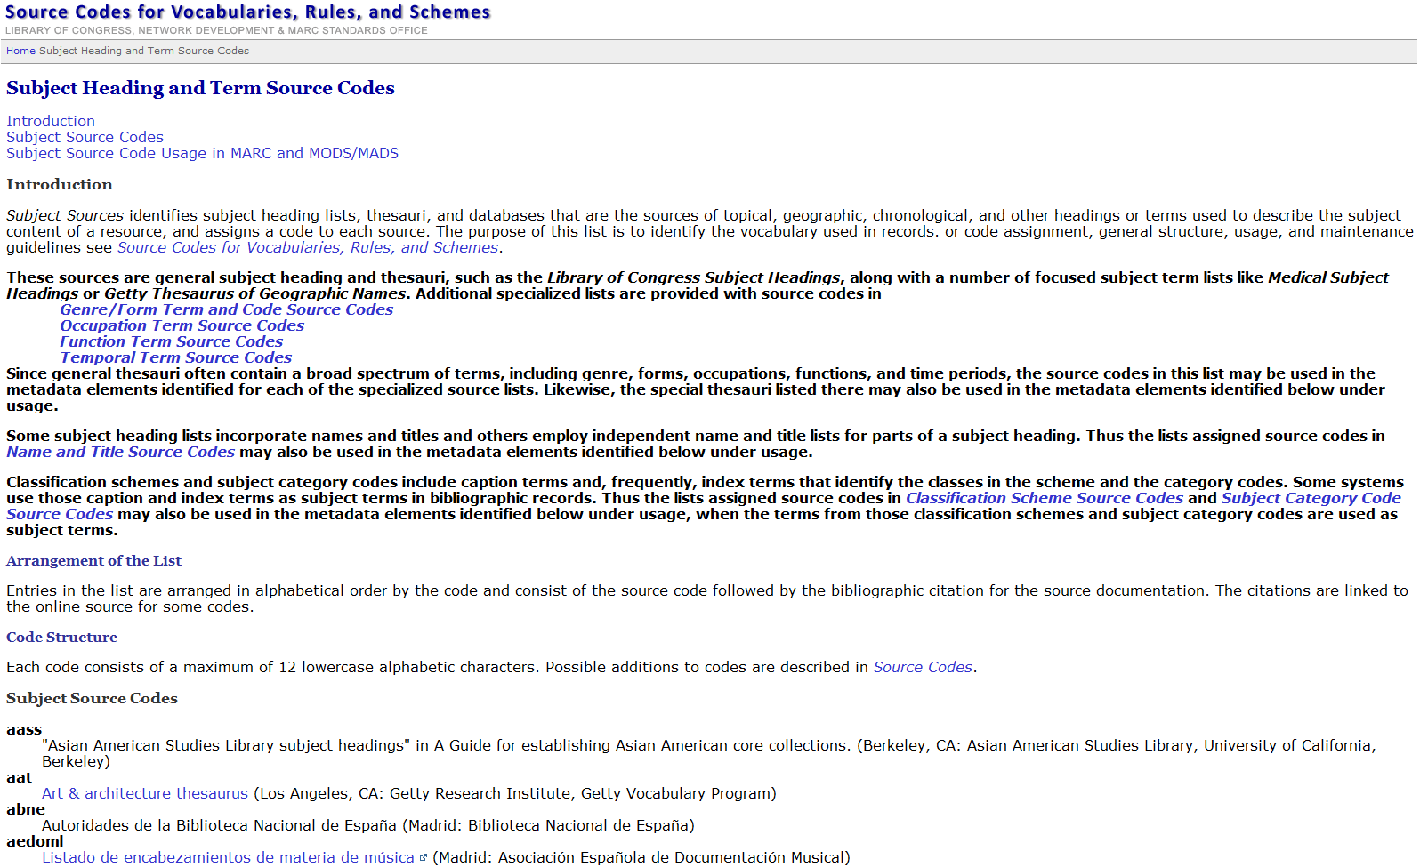
Notes:
Screen shot of Subject Heading and Term Source Codes. It’s a very long list, and only the first four codes in the list are shown at the bottom of the slide.

Slide 15
Which Vocabularies to Use?
LC is developing a new vocabulary specifically for use in the 385 and 386 fields: Library of Congress Demographic Group Terms (LCDGT). First group of terms are expected to be available by June 2015.
Will include many terms not found in LCSH, including terms for language speakers (e.g., German language speakers) and demonyms for persons from states, provinces, regions, etc. (e.g., Oregonians)
Will include terms in noun phrase form that are expressed in LCSH as [Main heading]--[Subdivision] strings (e.g., Breast cancer patients rather than Breast--Cancer--Patients)
LCDGT authority records will specify what demographic group categories a term falls into by using codes in 072 field
SACO libraries will be able to propose additional terms and revisions
Notes:
The primary source for access to the approved terms will be Classification Web, and the terms will also be made freely available on LC’s web site. Hopefully, with enough interest, people will convince OCLC to make the terms available through Connexion, so you can search the authorities there.

Slide 16
LCDGT
Sample authority records. Some terms will have broader terms, but not all. 072 will contain codes for the demographic group categories that the term falls into.
010 __ dg2015000100 010 __ dg2015000101
040 __ DLC $b eng $c DLC $e lcdgt 040 __ DLC $b eng $c DLC $e lcdgt
072 _7 gdr $2 lcdgt 072 _7 eth $a rel $2 lcdgt
150 __ Women 150 __ Jews
450 __ Females 450 __ Jewish people
010 __ dg2015000102 010 __ dg2015000103
040 __ DLC $b eng $c DLC $e lcdgt 040 __ DLC $b eng $c DLC $e lcdgt
072 _7 occ $2 lcdgt 072 _7 nat $2 lcdgt
150 __ Pediatricians 150 __ Oregonians
450 __ Paediatricians 550 __ $w g $a Americans
550 __ $w g $a Physicians
Notes:
The LCDGT authority records will have an LCCN with a prefix that begins with dg. 040 $e will specify the particular type of authority record. The 072 will have one or more codes for the demographic group categories that the authorized term belongs too. Although these records will have tags 150, 450, and 550, the terms will not be used as topical subject headings in field 650. They will only be used in fields 385 and 386.
Slide modified from a presentation by Janis L. Young, “Library of Congress Update to the Authority Control Interest Group: 2014 ALA Midwinter Meeting”

Slide 17
Recording Audience Characteristics
In subject headings as currently done – either with main subjects or form subdivisions
In fixed field Audn (008/22; 006/05)
In 521 Target Audience Note
In new 385 Audience Characteristics field
Not in 655 (usually)
245 00 Information everywhere : $b the world explained in facts, stats, and graphics.
385 __ $n age $a Children $2 lcdgt
650 _0 Children’s encyclopedias and dictionaries.
650 _0 Almanacs, Children’s.
655 _7 Encyclopedias. $2 lcgft
655 _7 Almanacs. $2 lcgft
Notes:
Eventually, we won’t need the 650s in this record, since the 650 will be used exclusively to describe what a resource is ABOUT. But for now, it’s ok to continue to assign LCSH headings in 650 and then LCGFT terms in 655 in combination with the audience term in 385. The 385 is not yet required, but it’s not a bad idea to start practicing including it, so you’ll already be comfortable with it when LC and PCC and other libraries begin using it as a matter of course. You’ll also want to determine how your ILS and discovery systems will work with the new 3XX fields, and develop indexes or facets to allow users to search the data contained in them.
Reminder: eventually, we will use a controlled vocabulary specifically developed for use in the 385 and 386 fields: LCDGT. The examples in the rest of this presentation use terms from existing vocabularies that you can use right now.
It is likely that LC will not use subfield $m or $n in its records. The LCDGT authority records will contain an 072 field with the demographic group codes that a particular term fits under.
LCGFT does include some terms that include audience, but they may eventually get cancelled. Examples: Cartographic materials for people with visual disabilities; Children’s atlases; Children’s audiobooks; Children’s films; Video recordings for people with visual disabilities; Video recordings for the hearing impaired
Note: The examples in this section of slides use LCGFT general, literature, or music terms in field 655. We will be talking more about each of those later on today. For now, the focus is the 385 and 386.

Slide 18
Recording Audience Characteristics
100 1_ Dees, David B., $e author.
245 10 Quick Spanish for emergency responders : $b essential words and phrases for firefighters, paramedics, and EMTs / $c David B. Dees.
385 __ $n occ $a Emergency Responders $2 mesh
385 __ $n occ $a Emergency medical technicians $a Fire fighters $2 lcsh
650 _0 Spanish language $v Conversation and phrase books (for medical personnel)
650 _0 Spanish language $v Conversation and phrase books (for fire fighters)
655 _7 Phrase books. $2 lcgft
and/or
Notes:
The slide illustrates different controlled vocabulary terms. The first 385 is from MeSH (Medical Subject Headings), the second has two terms from LCSH. You may stick with one vocabulary, or use multiple vocabularies. Different libraries may prefer different vocabularies. This is not a problem, as the field is repeatable and you can add additional fields with different terminology to OCLC master records.

Slide 19
Recording Audience Characteristics
245 00 This family is driving me crazy : $b ten stories about surviving your family / $c edited by M. Jerry Weiss and Helen S. Weiss.
385 __ $m Age group $a Teenagers $2 lcsh
385 __ $m Age group $a Adolescents $2 ericd
650 _0 Families $v Juvenile fiction.
655 _7 Short stories. $2 lcgft
655 _7 Domestic fiction. $2 lcgft
and/or
Notes:
In this case, two different terms are shown from LCSH and the Thesaurus of ERIC Descriptors, an education controlled vocabulary.
The slide also shows the use of $m instead of $n. Either is permissible. Be sure to use the group terms or codes exactly as found in the Library of Congress Demographic Group Term and Code List.

Slide 20
Recording Audience Characteristics
100 1_ Wichtrup, Matthias, $e composer, $e arranger of music, $e performer.
245 10 Modern piano style for blind and vision-impaired students. $n Lesson 1, $p Let's go west / $c all tracks composed, arranged, performed and produced by Matthias Wichtrup.
382 01 piano $n 1 $s 1 $2 lcmpt
385 __ Blind $a People with visual disabilities $2 lcsh
500 __ “The method is based on a basic chord-playing style ... The student is not playing any melodies but accompanies other lead instruments. This programme ... covers a wide variety of modern music”--Insert.
650 _0 Piano $v Methods (Popular music)
650 _0 Music for the blind.
650 _0 Music for people with visual disabilities.
655 _7 Popular music. $2 lcgft
655 _7 Methods (Music) $2 lcgft

Slide 21
Recording Creator/Contributor Characteristics
In subject headings as currently done – either with main subjects or topical or geographic subdivisions
In new 386 Creator/Contributor Characteristics field
Not in 655
245 00 Chicks dig comics / $c edited by Lynne M. Thomas, Sigrid Ellis.
386 __ $n gdr $a Women $2 lcsh
386 __ $n nat $a Americans $2 lcsh
520 __ A collection of essays by award-winning women writers and artists celebrating the comics medium and its creators.
650 _0 Comic books, strips, etc. $x History and criticism.
650 _0 Comic books, strips, etc. $x Appreciation.
650 _0 American essays $x Women authors.
655 _7 Essays. $2 lcgft
Notes:
The third 650 will probably not be necessary in the future, but for now you should continue to assign subjects as you have been, while adding LCGFT terms in 655 and audience and creator characteristics in 385 and 386.

Slide 22
Recording Creator/Contributor Characteristics
100 1_ Lindgren, Astrid, $d 1907-2002, $e author.
240 10 Pippi Långstrump. $l English
245 10 Pippi Longstocking / $c Astrid Lindgren ; illustrated by Lauren Child ; translated by Tiina Nunnally.
385 __ $m Age group $a Children $2 lcsh
386 __ $m Nationality/regional group $a Swedes $2 lcsh
386 __ $m Gender group $a Women $2 lcsh
600 10 Longstocking, Pippi $v Juvenile fiction.
650 _0 Girls $z Sweden $v Juvenile fiction.
651 _0 Sweden $v Juvenile fiction.
655 _7 Fiction. $2 lcgft
Notes:
This slide shows that you may use the 385 and 386 fields for individual works as well as for compilations.

Slide 23
Recording Creator/Contributor Characteristics
245 00 散文時代.
245 00 Sanmun sidae.
310 __ Semiannual
386 __ $n nat $a Koreans $2 lcsh
650 _0 Korean essays $v Periodicals.
655 _7 Essays. $2 lcgft
655 _7 Periodicals. $2 lcgft

Slide 24
Recording Creator/Contributor Characteristics
245 00 Deaf American prose 1830-1930 / $c Jennifer L. Nelson and Kristen C. Harmon, editors.
386 __ Deaf $a Americans $2 lcsh
386 __ Persons With Hearing Impairments $2 mesh
386 __ Americans $2 lcsh
650 _0 Deaf, Writings of the, American.
650 _0 American literature $y 19th century.
650 _0 American literature $y 20th century.
655 _7 Literature. $2 lcgft
655 _7 Creative nonfiction. $2 lcgft
or
Notes:
Eventually, we won’t need the 650s in this record, since the 650 will be used exclusively to describe what a resource is ABOUT. But for now, it’s ok to continue to assign LCSH headings in 650 and then LCGFT terms in 655 in combination with the audience term in 386.

Slide 25
Recording Creator/Contributor Characteristics
245 00 Night is gone, day is still coming : $b stories and poems by American Indian teens and young adults / $c edited by Annette Piña Ochoa, Betsy Franco, and Traci L. Gourdine ; introduction by Simon J. Ortiz.
386 __ $n eth $a American Indians $2 ericd or Indians of North America $2 lcsh
386 __ $n nat $a Americans $2 lcsh
386 __ $n age $a Teenagers $a Young adults $2 lcsh or Adolescents $a Young Adults $2 ericd
650 _0 American literature $x Indian authors.
650 _0 American literature $y 21st century.
650 _0 Teenagers' writings, American.
650 _0 Youths' writings, American.
655 _7 Short stories. $2 lcgft
655 _7 Poetry. $2 lcgft
Notes:
Eventually, we won’t need the 650s in this record, since the 650 will be used exclusively to describe what a resource is ABOUT. But for now, it’s ok to continue to assign LCSH headings in 650 and then LCGFT terms in 655 in combination with the audience term in 386.

Slide 26
Recording Creator/Contributor Characteristics
245 00 Love + relAsianships : $b a collection of contemporary Asian-Canadian
drama / $c edited by Nina Lee Aquino.
386 __ $n eth $a Asian Canadians $2 cash
386 __ $n nat $a Canadians $2 lcsh
650 _0 Canadian drama $x Asian authors.
650 _0 Canadian drama $y 20th century.
650 _0 Canadian drama $y 21st century.
650 _5 Canadian drama (English) $x Asian Canadian authors.
650 _5 Canadian drama (English) $y 20th century.
650 _5 Canadian drama (English) $y 21st century.
655 _7 Drama. $2 lcgft
Notes:
This slide illustrates again that terms used in 385 and 386 can be taken from other controlled vocabularies besides LCSH, in this case Canadian Subject Headings. Library and Archives Canada has established many headings for Canadian ethnic groups comparable to one for American groups found in LCSH. Since LCSH does not include these kinds of compound terms (Asian Canadians, Chinese Canadians, Italian Canadians, Russian Canadians, etc.) but CaSH does, you can take terms found there and use them. Eventually, we expect that LCDGT will have terms like these for non-American ethnic groups.

Slide 27
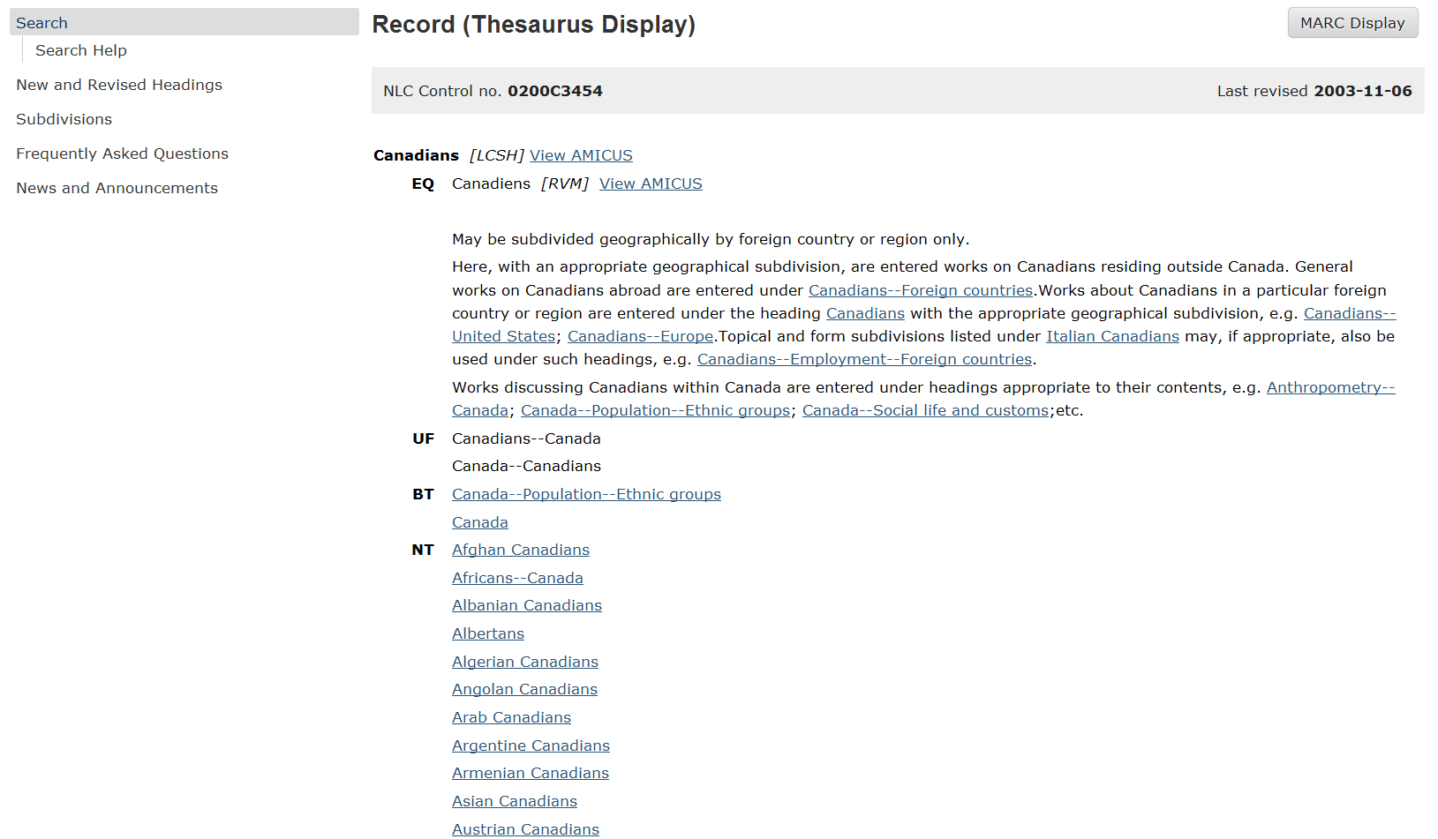
Notes:
Screenshot from Canadian Subject Headings showing some of the many narrower terms established under Canadians
URL for Canadian Subject Headings search: http://www.collectionscanada.gc.ca/csh-bin/search/

Slide 28
Recording Creator/Contributor Characteristics
245 00 Blooming in the shade : $b five Oregon poets / $c Ashira Belsey,
Maxine Borcherding, Joan Maiers, Judith Massee, Sharon Roso.
386 __ $n gdr $a Women $2 lcsh
386 __ $n nat $a Americans $a Oregonians $2 lcdgt
650 _0 American poetry $z Oregon.
650 _0 American poetry $x Women authors.
650 _0 American poetry $y 20th century.
655 _7 Poetry. $2 lcgft
Notes:
LCSH does not include demonyms (names for people from a particular place) for U.S. states, Canadian provinces, and other first-order political divisions of other countries, but it is likely that LCDGT will. Currently we use a geographic subdivision with a form/genre heading in LCSH to express the geographic origin of works. Since the geographic aspect is not part of LCGFT, it needs to be brought out in another way. One way is through a demographic group term that could be used in field 386. Another way is to record the place in another appropriate field. Possible fields include 257 (for place of production of a work); 370 (associated place) subfields $c, $f, or $g (however, this field is not yet implemented in OCLC bibliographic records); and 751 (added entry—geographic name). National practices and PCC policy has not yet been determined for this, so stay tuned.

Slide 29
Exercise s
Examine the five resources shown in the following slides.
Could/would you include a 385 and/or 386 field in bib records for them?
If yes, what demographic group categories are relevant to each? (e.g., age group, ethnicity, gender, etc.)
Without worrying about what actual controlled terms you might use, identify demographic/class of persons terms that you might you want to record in the 385 and/or 386 fields (e.g., senior citizens, serial killers, Internet addicts)

Slide 30
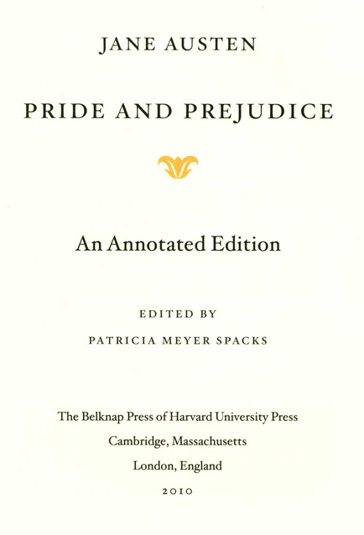
Notes:
Audience: ?
Creator characteristics: nationality: British/English; gender: Women; occupation: Novelist

Slide 31
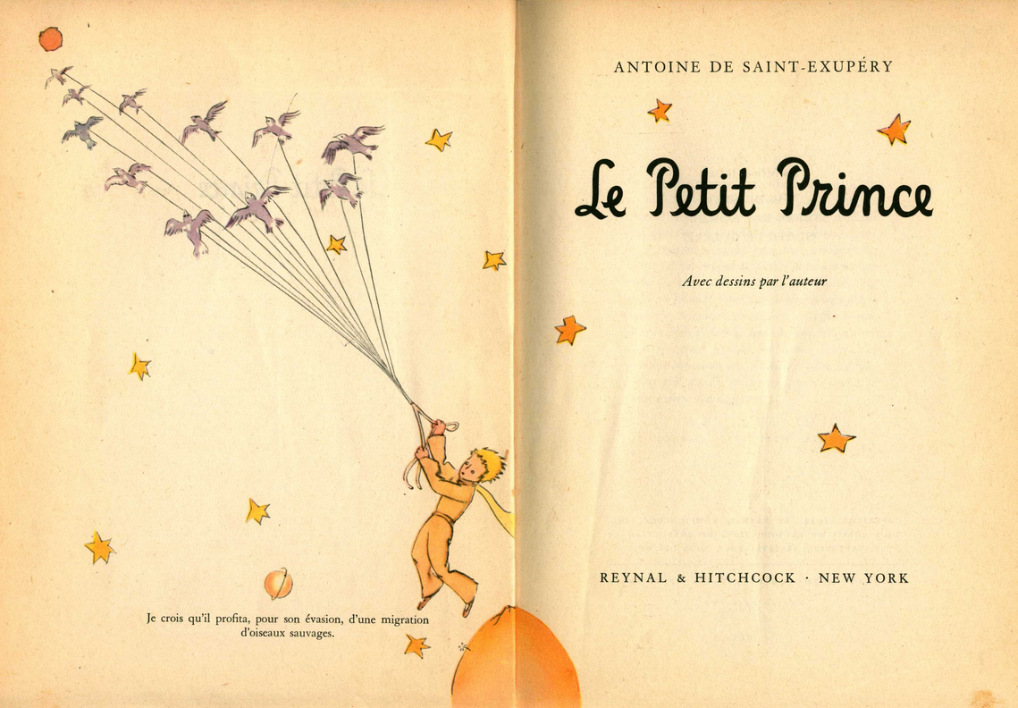
Notes:
Audience: Children
Creator/contributor characteristics: nationality: French; gender: Men; occupation: Aviators/Air pilots; social class: Nobles (he was a count)/Aristocrats

Slide 32
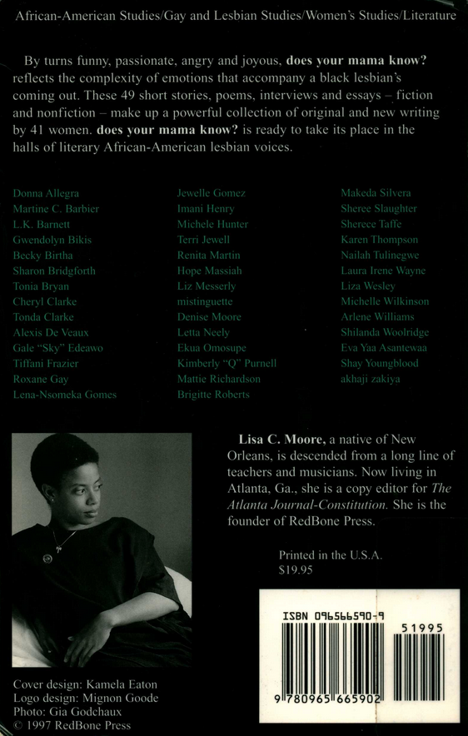
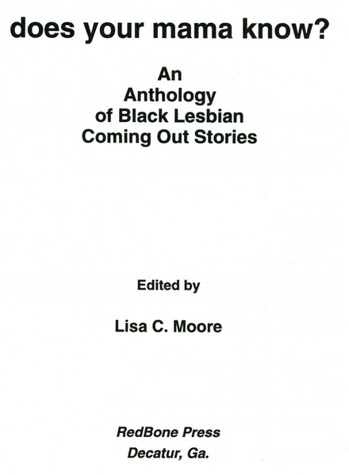
Notes:
Audience: ?
Creator characteristics: ethnicity: African Americans; nationality: Americans; gender: Women; sexual orientation: Lesbians

Slide 33
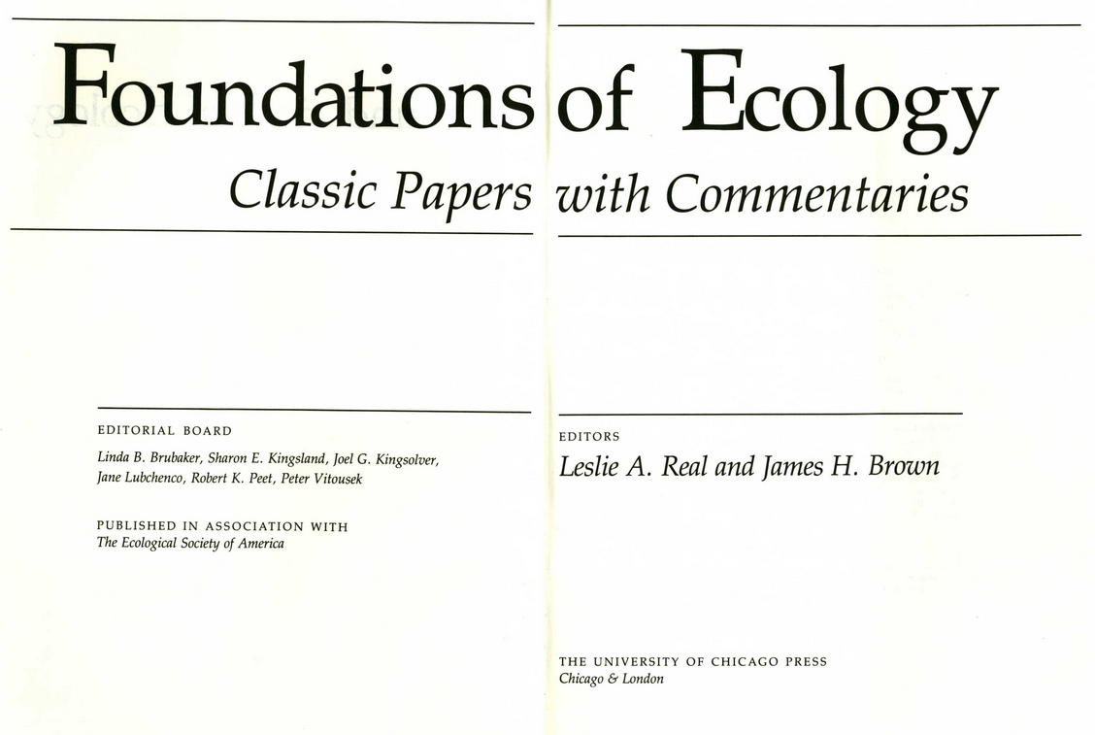
See also next slide for table of contents
Notes:
Audience: ? None probably needed, but could be Ecologists, Biologists, Ecology students
Creator characteristics: occupation: Ecologists, Biologists, and/or Scientists. The authors of the papers are from around the world, so no nationality is required. Most, but not all are by men, so probably no gender would be recorded.

Slide 34
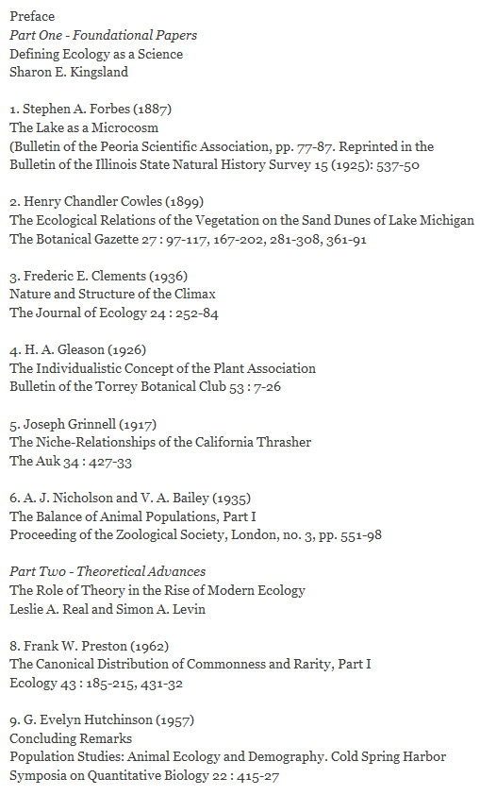
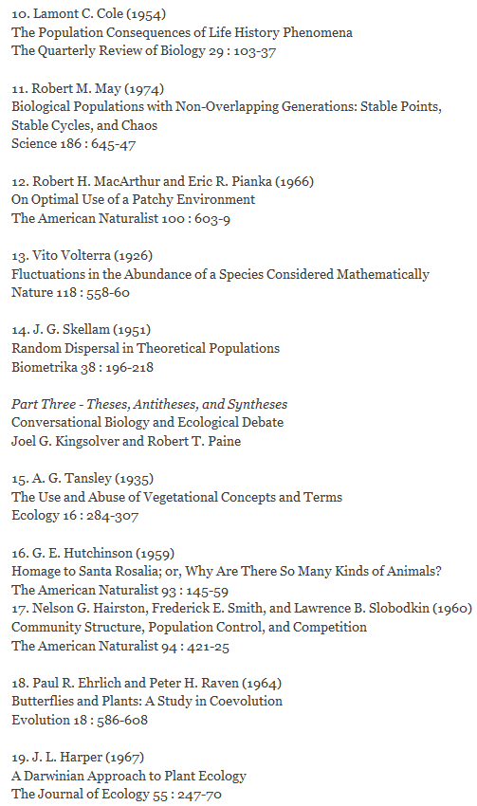
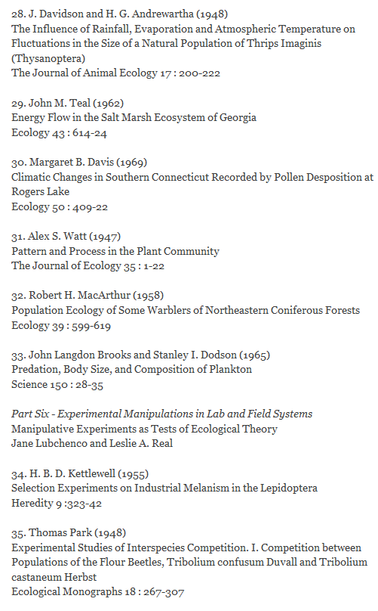
Notes:
Audience: ? None probably needed, but could be Ecologists, Biologists, Ecology students
Creator characteristics: occupation: Ecologists, Biologists, and/or Scientists. The authors of the papers are from around the world, so no nationality is required. Most, but not all are by men, so probably no gender would be recorded.

Slide 35
Rhyme Time A Collection of Poetry by the Children of Oregon compiled by John M. Reed & Lillián E. Gillman Other Eye Exercises Kirkland, WA ©1988
Notes:
Audience: ? [at the OLA genre/form preconference, one attendee suggested: parents of children of Oregon ;-)]
Creator characteristics: age: children; nationality/regional group: Oregonians, Americans

Slide 36
Policies for Assignment of LCGFT Terms
ALCTS Subject Analysis Committee Subcommittee on Genre/Form Implementation is working on a genre/form headings manual along the lines of the Subject Headings Manual
The following slides are based on draft policies that LC PSD and the Subcommittee have agreed to
LC PSD will also be revising sections of the SHM this spring and summer
Until revised policies are published, LC recommends that you continue to assign subject headings as you always have, but then also add LCGFT terms in 655
Don’t forget 385/386 as well!

Slide 37
Policies for Assignment of LCGFT Terms
Order of Terms:
If the classification number reflects a genre or form, put that term first
If there is a predominant genre or form, assign the term that represents that genre or form as the first term. If the predominant genre or form cannot be represented by a single term, assign as the first group of terms those that, taken together, express the predominant form. For example, for a biographical dictionary, assign both Biographies and Dictionaries. The order doesn’t matter unless the first bullet above applies.
If two equally important genres or forms: assign terms for both as the first and second headings. The order doesn’t matter unless first bullet above applies. For example, for an annual report consisting of statistics, assign both Annual reports and Statistics.
Notes:
These are some policies being worked out by the ALCTS SAC Subcommittee on Genre/Form Implementation and LC PSD.

Slide 38
Policies for Assignment of LCGFT Terms
Assign to both individual works and compilations
Number of Terms:
No limit to how many terms can be assigned. But they should reflect the preponderant genres and forms exemplified by the resource being cataloged. Apply your judgment as to which genres and forms are significant enough to provide access to.
For example, do not assign Indexes to every book that happens to have an index. Assign Indexes to resources that essentially are indexes (i.e., in fixed field you’ve coded Cont (Nature of Contents) with value “i” and you’ve used subdivision $v Indexes in subjects).
Notes:
These are some policies being worked out by the ALCTS SAC Subcommittee on Genre/Form Implementation and LC PSD.

Slide 39
Policies for Assignment of LCGFT Terms
Specificity:
Assign headings that are as specific as the genres/forms exemplified by a resource. Any given heading may be specific or general depending on the particular resource being cataloged. For example, the heading Poetry is specific when assigned to an anthology of poetry that isn’t in any particular poetic form or genre. But it is too broad when assigned to a collection consisting only of sonnets.
If the resource is classified based on a more general or broader term, assign that term as the first one, and then assign more specific ones that reflect the actual content of the resource.
Notes:
These are some policies being worked out by the ALCTS SAC Subcommittee on Genre/Form Implementation and LC PSD.

Slide 40
Policies for Assignment of LCGFT Terms
LCGFT vs. Other Thesauri/Term Lists:
Assign LCGFT terms in addition to any other terms used in field 655 that are taken from other genre/form or subject lists. For example, for an ethnic newspaper, assign the LCGFT term Newspapers as well as any more specific terms taken from the Newspaper Genre List.
245 00 西華報 = $b Seattle Chinese post.
245 00 Xi hua bao = $b Seattle Chinese post.
650 _0 Chinese Americans $z Washington (State) $z Seattle $v Newspapers.
650 _0 Chinese $z Washington (State) $z Seattle $v Newspapers.
655 _7 Newspapers. $2 lcgft
655 _7 Chinese American newspapers. $2 ngl

Slide 41
Policies for Assignment of LCGFT Terms
MARC Coding:
Assign LCGFT terms in field 655, second indicator value “7”, and subfield $2 code “lcgft”
Control the headings in OCLC Connexion
Subdivision of LCGFT terms is not authorized. If your library has a special policy for subdividing LCGFT terms, they should be coded with $2 code “local”
655 _7 Feature films. $2 lcgft
655 _7 Feature films $z United States. $2 local

Slide 42
Policies for Assignment of LCGFT Terms
MARC Coding:
Subfield $3 may be used to indicate what part a particular heading applies to
245 00 Encyclopedia of the social and cultural foundations of education ...
300 __ 1 online resource (3 volumes (xxxvii, 1296 pages)) : $b illustrations
505 0_ volume 1. A-H -- volume 2. I-Z -- volume 3. Biographies of important figures in education.
655 _7 Encyclopedias. $2 lcgft
655 _7 $3 volume 3: $a Biographies. $2 lcgft

Slide 43
Policies for Assignment of LCGFT Terms
MARC Coding:
Subfield $3 may be used to indicate what part a particular heading applies to
245 12 A tactile and large print atlas of the state of Maryland ...
300 __ 1 atlas (2 volumes) : $b tactile maps (some color) ; $c 30 cm + $e 4
audiocassettes
505 0_ part 1. Atlas -- part 2. Commentary in print -- part 3. Commentary on 4 audio cassettes.
655 _7 Atlases. $2 lcgft
655 _7 Braille books. $2 lcgft
655 _7 Cartographic materials for people with visual disabilities. $2 lcgft
655 _7 $3 Accompanying material: $a Audiobooks. $2 lcgft

Slide 44
Policies for Assignment of LCGFT Terms
MARC Coding:
Subfield $3 may be used to indicate what part a particular heading applies to
100 1_ Pinero, Arthur Wing, $d 1855-1934, $e author.
245 10 Three plays / $c Arthur Wing Pinero ; with introductions by Stephen Wyatt.
505 0_ The magistrate -- The second Mrs. Tanqueray -- Trelawny of the “Wells.”
655 _7 Drama. $2 lcgft [Genre/form term that applies to all works in the compilation]
655 _7 $3 The magistrate: $a Farces. $2 lcgft
655 _7 $3 The second Mrs. Tanqueray: $a Problem plays. $2 lcgft
655 _7 $3 Trelawny of the “Wells”: $a Comedy plays. $2 lcgft
Notes:
Note: at the time these slides were prepared in early March 2015, these literature genre/form terms were not yet approved.

Slide 45
Policies for Assignment of LCGFT Terms
MARC Coding:
Subfield $3 may be used to indicate what part a particular heading applies to
245 04 The gold rush ; $b plus, Pay day / $c Film de Dam ; written and
directed by Charlie Chaplin.
655 _7 Comedy films. $2 lcgft
655 _7 Silent films. $2 lcgft
655 _7 Fiction films. $2 lcgft
655 _7 $3 Gold rush: $a Feature films. $2 lcgft
655 _7 $3 Pay day: $a Short films. $2 lcgft

Slide 46
General Terms

Slide 47
Background Information
ALA ALCTS Subject Analysis Committee Subcommittee on Genre/Form Implementation General Terms Working Group developed initial list of terms
The WG initially looked at LCSH free-floating form subdivisions, and then at non-floating form subdivisions, general form headings in LCSH, and other controlled vocabularies (e.g., RBMS Genre Terms)
Terms that are not specific to a particular discipline (e.g., Annual reports; Dictionaries; Exhibition catalogs; Indexes)
Some other terms that do not fall neatly into a particular discipline (e.g., Logic puzzles; Passenger lists)
Some non-fiction literary terms (e.g., Autobiographies; Diaries; Essays; True crime stories)

Slide 48
Background Information
PSD has no plans at this time to cancel any of the LCSH headings or form subdivisions that overlap with the “general” terms. Libraries choosing to implement the terms in their cataloging should assign them in addition to subdivided subject headings.
LC has not yet decided when it will implement the “general” genre/form terms in new cataloging

Slide 49
Monthly List 2015-13
In January 2015, LC approved about 190 “general” terms to add to LCGFT
Many have corresponding headings or form subdivisions in LCSH, but the LCGFT headings may not be identical. For example:
LCSH: $v Biography LCSH: $v Congresses
LCGFT: Biographies LCGFT: Conference papers and proceedings
LCSH: $v Handbooks, manuals, etc. LCSH: Imaginary histories
LCGFT: Handbooks and manuals LCGFT: Counterfactual histories
LCSH: Playbills LCSH: Sound effects books
LCGFT: Playbills (Posters) LCGFT: Sound books
Notes:
All LCGFT terms are in the plural form, unlike some LCSH headings.

Slide 50
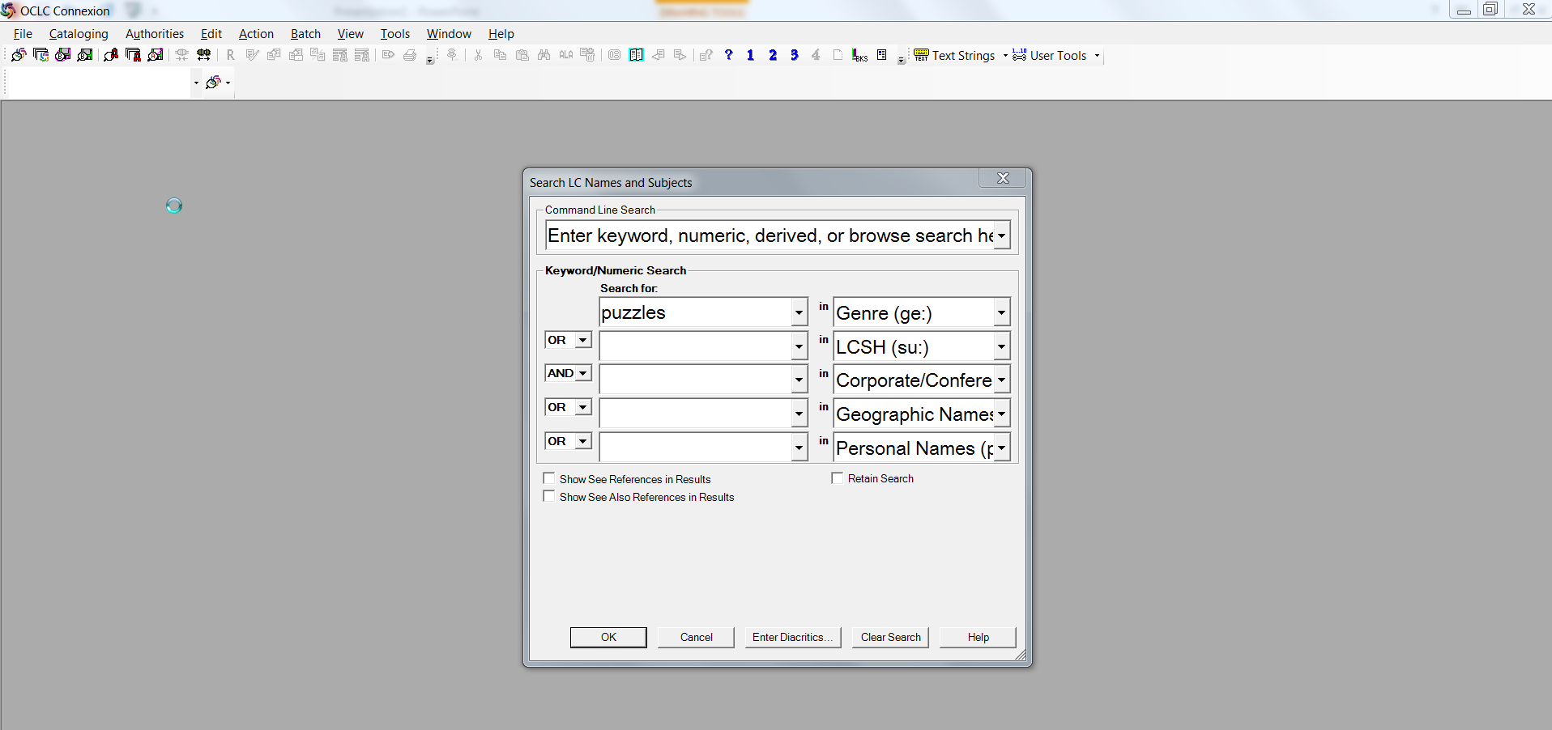
Monthly List 2015-13
Can see the approved list in the Classification Web subject proposal system: http://classificationweb.net/approved-subjects/1513.html
Genre/form authority records are in OCLC
Notes:
The slide shows a genre/form authority record keyword search in OCLC Connexion on the word “puzzles.”

Slide 51
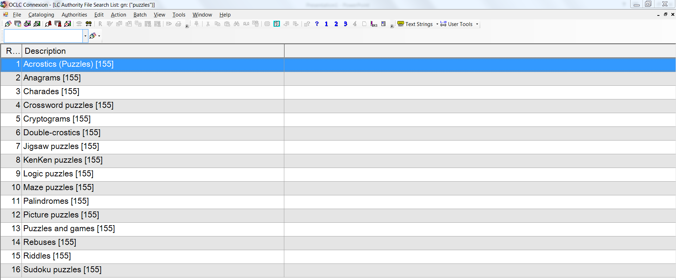
LCGFT General Terms
Notes:
Results of the genre/form authority keyword search on “puzzles”

Slide 52
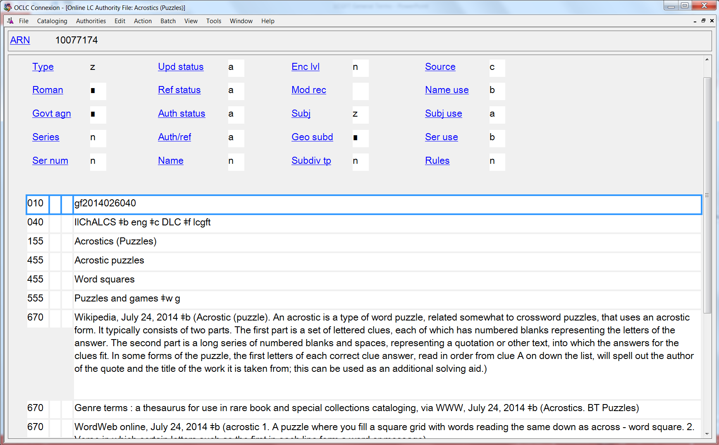
Monthly List 2015-13
Notes:
LCGFT authority record in OCLC

Slide 53
LCGFT General Terms
Can also see the terms in
Classification Web
Library of Congress Authorities (http://authorities.loc.gov/)
LC Linked Data Service (id.loc.gov)
Free PDF on Library of Congress Subject Headings PDF Files website (http://www.loc.gov/aba/publications/FreeLCSH/GENRE.pdf)

Slide 54
LCGFT General Terms
Divided into 10 “top” terms: Commemorative works; Creative nonfiction; Derivative works; Discursive works; Ephemera; Illustrated works; Informational works; Instructional and educational works; Recreational works; Tactile works
These are mainly for gathering the general terms into a broad category; they will rarely be assigned in a bibliographic record because more specific terms are available
Some of the more specific terms may be in the hierarchies of multiple top terms. For example, Handbooks and manuals has two BTs, Instructional and educational works and Reference works, which is an NT of Informational works

Slide 55
LCGFT General Terms
To see a hierarchical arrangement of the general terms:
http://www.loc.gov/catdir/cpso/genre_form_general_terms_hierarchies.pdf

Slide 56
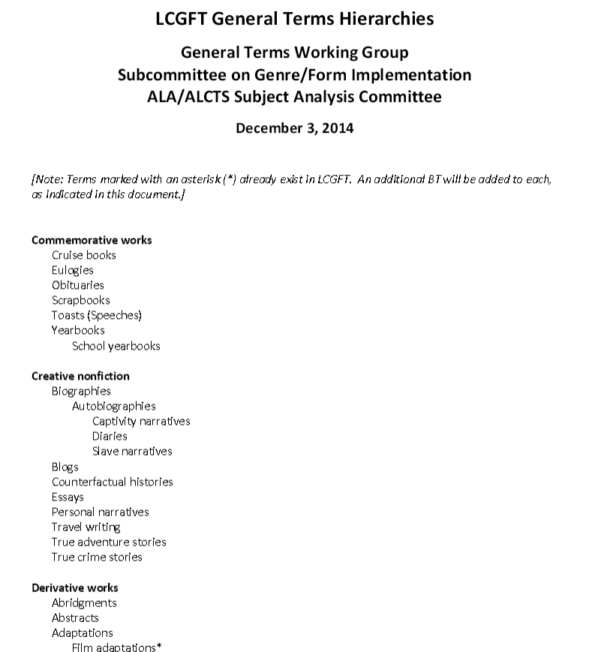
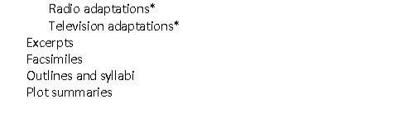
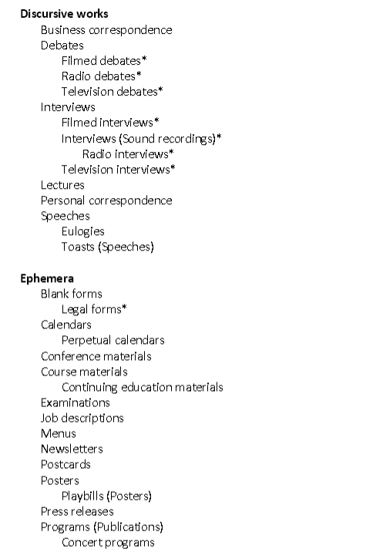
Notes:
LC has posted a hierarchical arrangement of the general terms. Note that the current version online, dated December 3, 2014, does not reflect any changes that LC may have made to the records during the editorial process.

Slide 57
Examples
100 1_ Carbone, Gregory J., $e author.
245 14 The atmosphere, seventh edition, Frederick K. Lutgens, Edward J. Tarbuck : $b laboratory manual / $c Greg Carbone.
246 14 Laboratory manual, the atmosphere, seventh edition
650 _0 Atmosphere $v Laboratory manuals.
650 _0 Meteorology $v Laboratory manuals.
650 _0 Weather $v Laboratory manuals.
655 _7 Laboratory manuals. $2 lcgft
Notes:
Here’s a very simple case where the LCGFT term is identical to the LCSH form subdivision. It won’t always be this simple, however!

Slide 58
Examples
110 2_ College Bound Scholarship (Program : Wash.), $e author.
245 10 Program manual / $c College Bound Scholarship.
__ Annual
650 _0 Scholarships $z Washington (State) $v Handbooks, manuals, etc.
650 _0 Government aid to education $z Washington (State) $v Handbooks, manuals, etc.
650 _0 Student aid $x Government policy $z Washington (State) $v Handbooks, manuals, etc.
655 _7 Handbooks and manuals. $2 lcgft
655 _7 Serial publications. $2 lcgft
Notes:
Another example where the LCGFT term does not correspond exactly to the LCSH form subdivision. Catalogers must search the LCGFT genre/form authority records and use the headings found there. Don’t just copy LCSH form subdivisions into the 655 field.

Slide 59
Examples
100 1_ Gross, John, $d 1935-2011, $e compiler.
245 14 The Oxford book of aphorisms / $c chosen by John Gross.
650 _0 Aphorisms and apothegms.
655 _7 Sayings. $2 lcgft
100 1_ Cordry, Harold V., $d 1943- $e compiler.
245 14 The multicultural dictionary of proverbs : $b over 20,000 adages from more than 120 languages, nationalities, and ethnic groups / $c Harold V. Cordry.
650 _0 Proverbs.
655 _7 Sayings. $2 lcgft
Notes:
In some cases, a single term has been chosen in LCGFT to represent a number of different terms in LCSH.

Slide 60
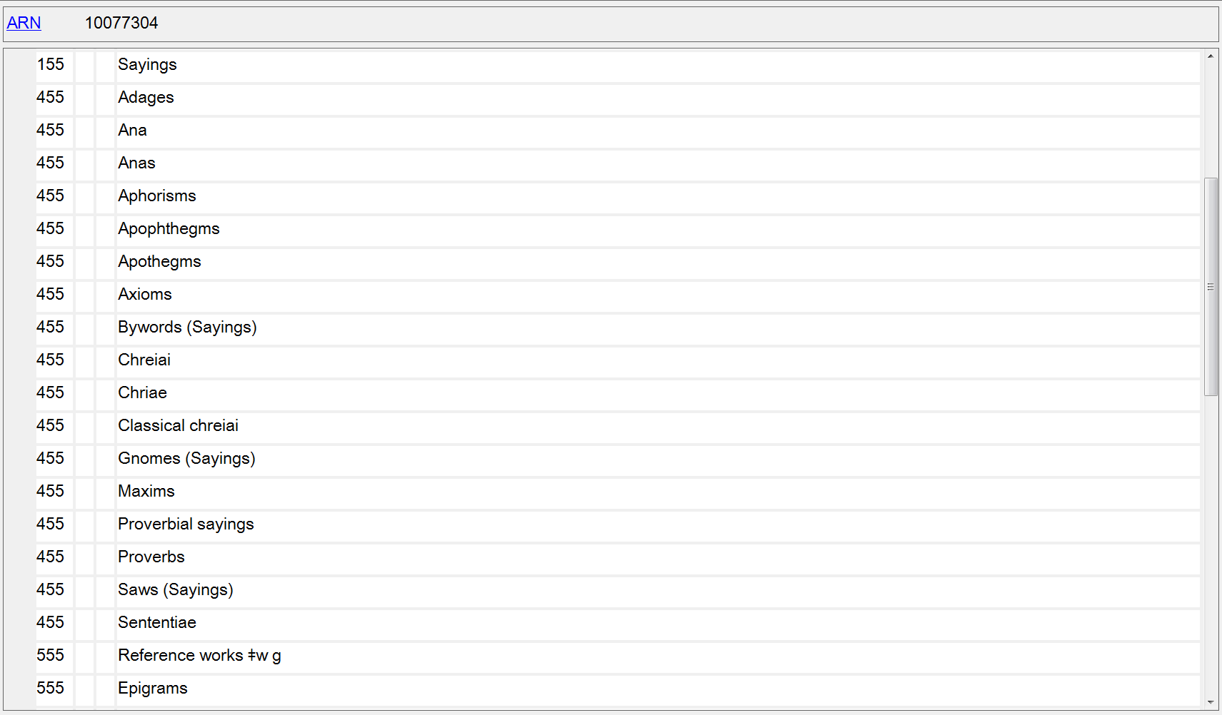
Notes:
The differences in meaning of the terms “Adages”, “Aphorisms”, “Maxims”, “Proverbs”, etc. are so small and hard to discern, and often overlap. A single general term, “Sayings” was chosen for LCGFT.

Slide 61
Examples
100 1_ Frank, Anne, $d 1929-1945, $e author.
240 10 Achterhuis. $l English
245 14 The diary of Anne Frank ...
600 10 Frank, Anne, $d 1929-1945 $v Diaries.
650 _0 Holocaust, Jewish (1939-1945) $z Netherlands $z Amsterdam $v Personal narratives.
650 _0 Jewish girls $z Netherlands $z Amsterdam $v Diaries.
650 _0 Jews $z Netherlands $z Amsterdam $v Diaries.
655 _7 Diaries. $2 lcgft
655 _7 Personal narratives. $2 lcgft
Notes:
Note: I have not shown all of the subjects that were assigned to this work, just the ones that have corresponding LCGFT terms.

Slide 62
Examples
100 1_ Crowther, Robert, $e author.
245 10 Amazing pop-up trucks / $c Robert Crowther.
520 __ Text and pop-up illustrations introduce five different kinds of trucks from cement truck to garbage truck, and explain what they can do.
650 _0 Trucks $v Juvenile literature.
650 _1 Trucks.
650 _1 Pop-up books.
650 _1 Toy and movable books.
655 _7 Pop-up books. $2 lcgft

Slide 63
Examples
245 00 The New York times theater reviews.
650 _0 Theater $z United States $v Reviews $v Periodicals.
655 _7 Theater reviews. $2 lcgft
655 _7 Serial publications. $2 lcgft
245 00 The New York times film reviews.
650 _0 Motion pictures $v Reviews $v Periodicals.
655 _7 Motion picture reviews. $2 lcgft
655 _7 Serial publications. $2 lcgft
Notes:
The form subdivision $v Periodicals is used in a much broader sense than the actual definition of the term. Although one might assign the LCGFT term Periodicals, probably the broader term Serial publications is more appropriate for this publication.
From the Subject Headings Manual H 1927: “In subject cataloging practice the term periodical is defined as a publication other than a newspaper that is actually or purportedly issued according to a regular schedule (monthly, quarterly, biennially, etc.) in successive parts, each of which bears a numerical or chronological designation, and that is intended to be continued indefinitely. This definition is broader than the traditional definition, which states that a periodical is generally published more frequently than annually and normally contains separate articles. The term serial is frequently used in a broader sense to refer to any title cataloged as a serial, including periodicals, newspapers, monographic series, etc. The subdivision –Periodicals is used under headings assigned to serials that conform to the subject cataloging definition of periodicals.”

Slide 64
Examples
111 2_ Vancouver Queer Film & Video Festival, $e author.
245 14 The ... Annual Vancouver Queer Film & Video Festival : $b festival guide.
310 __ Annual
611 20 Vancouver Queer Film & Video Festival $v Periodicals.
650 _0 Gay and lesbian film festivals $z British Columbia $z Vancouver $v Periodicals.
655 _7 Film festival programs. $2 lcgft
655 _7 Serial publications. $2 lcgft
Notes:
Note: I have not shown all of the subjects that were assigned to this work, just the first two.

Slide 65
Examples
245 00 Tidal current tables. $p Pacific coast of North America and Asia for the year ...
650 _0 Tidal currents $z Pacific Ocean $v Tables $v Periodicals.
650 _0 Tides $z Pacific Ocean $v Tables $v Periodicals.
650 _0 Tidal currents $z Pacific Coast (North America) $x Forecasting $v Periodicals.
650 _0 Tidal currents $z Pacific Coast (Asia) $x Forecasting $v Periodicals.
650 _0 Aids to navigation $z Pacific Coast (North America) $v Sources $v Periodicals.
650 _0 Aids to navigation $z Pacific Coast (Asia) $v Sources $v Periodicals.
655 _7 Tables (Data) $2 lcgft
655 _7 Serial publications. $2 lcgft

Slide 66
Examples
245 00 Oregon child fatality review ... annual report.
650 _0 Children $x Mortality $z Oregon $v Statistics $v Periodicals.
651 _0 Oregon $v Statistics, Vital $v Periodicals.
610 20 Oregon State Child Fatality Review Team $v Directories.
655 _7 Vital statistics. $2 lcgft
655 _7 Directories. $2 lcgft
655 _7 Annual reports. $2 lcgft
Notes:
Another situation in which the LCGFT term assigned does not correspond to the form subdivision used in the subject headings. Annual reports is the specific term appropriate to this work, so it is assigned. from LCGFT rather than Periodicals.

Slide 67
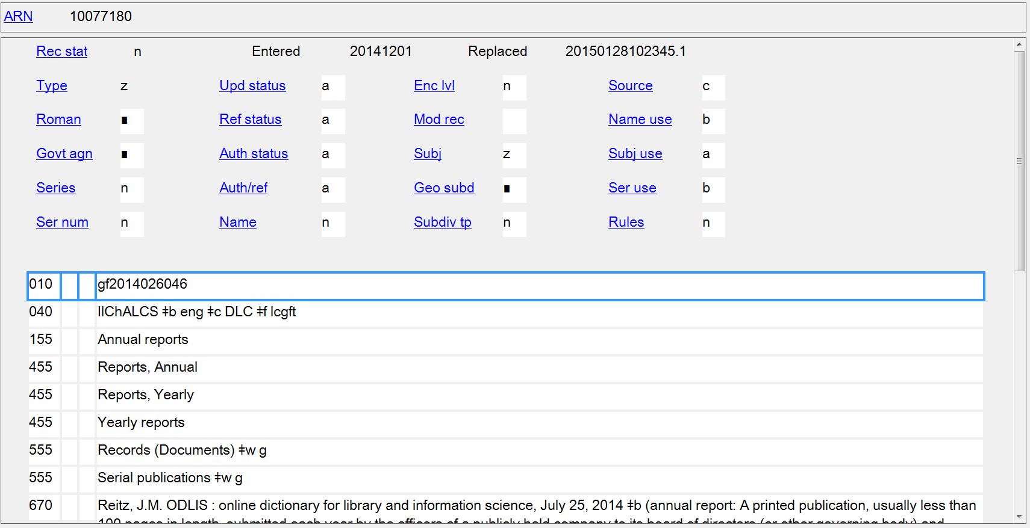

Slide 68
Examples
100 1_ Dior, Christian, $e author.
240 10 Christian Dior et moi
245 10 Christian Dior & moi / $c par Christian Dior.
600 10 Dior, Christian.
650 _0 Fashion designers $z France $z Paris $v Biography.
655 _7 Autobiographies. $2 lcgft
Notes:
Another example where a more specific LCGFT term is assigned in 655 than the form subdivision used in the subject headings. Since this work is an autobiography, Autobiographies is the correct term to assign to this work.

Slide 69
Policies for Assignment of General LCGFT Terms
Summary:
Continue to assign LCSH (600-651) as you have been, including any form subdivisions that are applicable and appropriate.
Assign in field 655 LCGFT terms equivalent to any forms or genres or form subdivisions that are in the subject headings (600-651), as well as any appropriate LCGFT terms not represented in subject headings.
Assign LCGFT in addition to any other 655 headings from other thesauri/term lists that may already be included in or added to the record. Generally, prefer LCGFT to other thesauri if the appropriate level of specificity is available in LCGFT. Catalogers may continue to assign 655 headings from other controlled vocabularies if terms are not in LCGFT. Use 655 _0 for terms taken from LCSH, 655 _2 for MeSH, and 655 _7 with $2 for terms taken from other vocabularies.

Slide 70
Policies for Assignment of General LCGFT Terms
Summary:
Except when found in LCGFT, generally do not assign terms in 655 that include aspects such as
Audience (e.g., Women's periodicals; Men’s magazines; Almanacs, Children’s; Wit and humor, Juvenile; Young adult fiction)
Characteristics of the Work or Expression’s Creators/Contributors (e.g., Children’s diaries; Canadian essays; Quotations, American; Personal narratives, Korean; College students' writings; Islamic almanacs; Christian literature)
Language (e.g., Chinese diaries; Speeches, addresses, etc., Arabic; Almanacs, Czech)
Time Period of Creation (e.g., Drama, Medieval; Manuscripts, Renaissance; Quotations, Early; Early printed books)
Notes:
There are a few exceptions to the basic principle that LCGFT does not include audience aspects, creator/contributor characteristics, language, or time period of creation. Some examples of existing LCGFT terms are: Children’s films; Children’s atlases; Law for laypersons; Video recordings for the hearing impaired; Cartographic materials for people with visual disabilities; Early maps; Town laws, Medieval. It is expected that once fields 385 (audience characteristics), 386 (creator/contributor characteristics), and 388 (time period of creation) are fully implemented, many of these LCGFT terms will be cancelled.

Slide 71
Exercises
Using the following list of LCGFT general terms, what terms would you add to your records for the resources shown in the slides?

Slide 72
Commemorative works
Cruise books
Eulogies
Obituaries
Scrapbooks
Toasts (Speeches)
Yearbooks
School yearbooks
Creative nonfiction
Biographies
Autobiographies
Captivity narratives
Diaries
Slave narratives
Blogs
Counterfactual histories
Essays
Personal narratives
Travel writing
True adventure stories
True crime stories
Derivative works
Abridgments
Abstracts
Adaptations
Excerpts
Facsimiles
Outlines and syllabi
Plot summaries
Discursive works
Business correspondence
Debates
Interviews
Lectures
Personal correspondence
Speeches
Eulogies
Toasts (Speeches)
Illustrated works
Charts
Cruise books
Emblem books
Photobooks
Picture dictionaries
Postcards
Posters
Playbills (Posters)
Toy and movable books
Flag books
Flip books
Glow-in-the-dark books
Lift-the-flap books
Photicular books
Pop-up books
Scented books
Sound books
Textured books
Tunnel books
Upside-down books
Informational works
Abstracts
Academic theses
Annals and chronicles
Blank forms
Blogs
Charts
Conference materials
Conference papers and
proceedings
Counterfactual histories
Databases
Essays
Family histories
Job descriptions
Menus
Plot summaries
Posters
Playbills (Posters)
Press releases
Programs (Publications)
Concert programs
Dance programs
Film festival programs
Opera programs
Theater programs
Records (Documents)

Slide 73
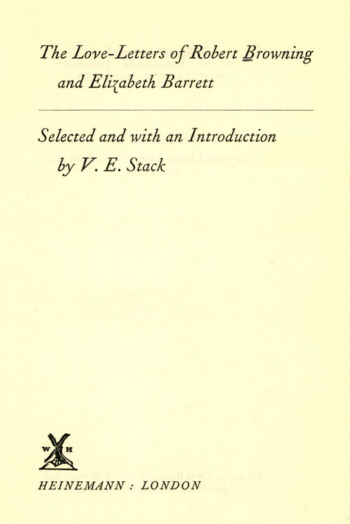
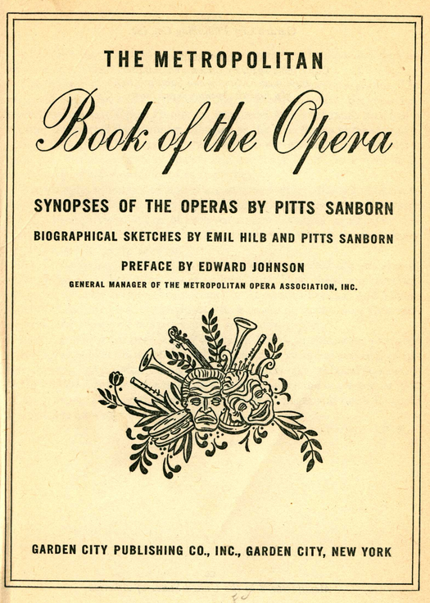
Notes:
First book: Personal correspondence
Second book: Plot summaries, and perhaps also Biographies if there is enough biographical content to be worth bringing that out

Slide 74
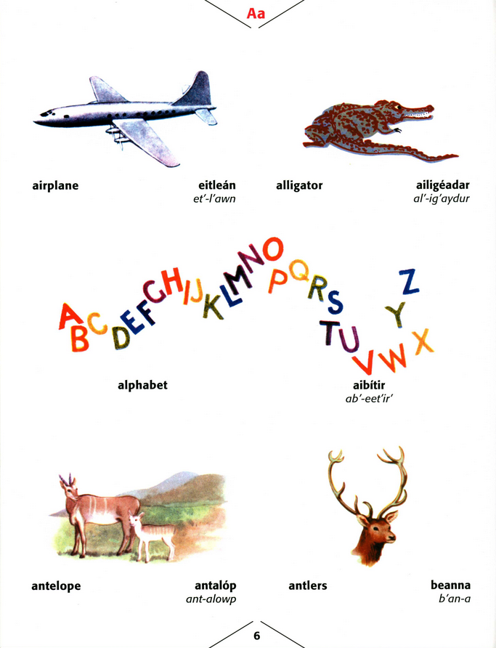
Notes:
Picture dictionaries

Slide 75
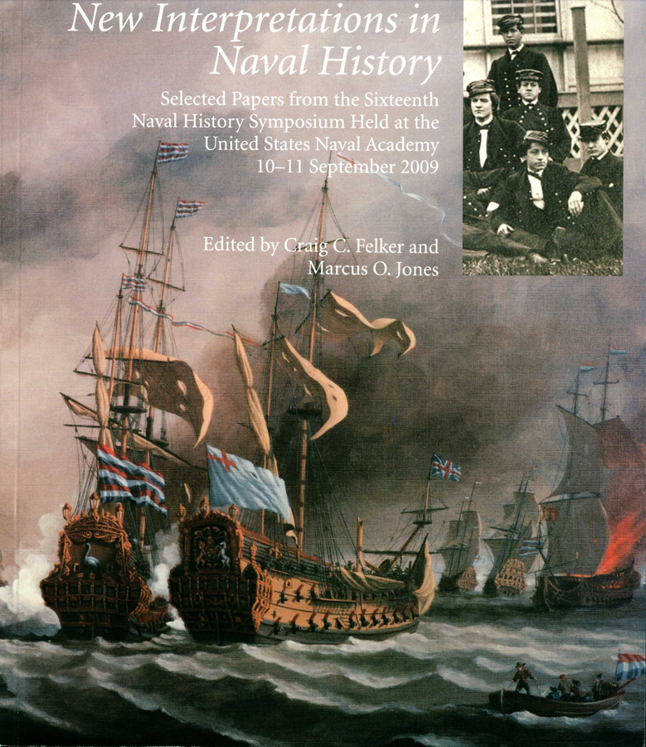
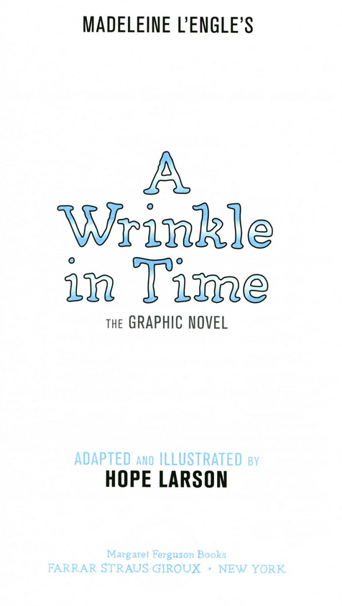
Notes:
First book: Conference papers and proceedings
Second book: Adaptations

Slide 76
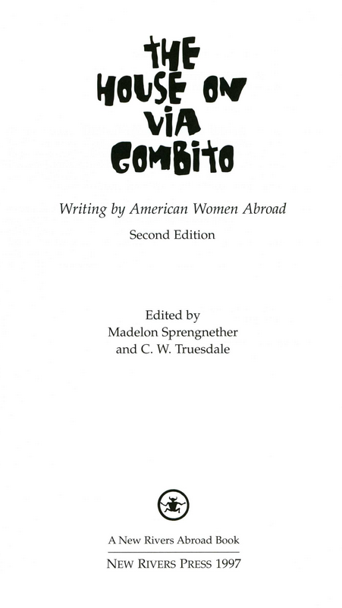
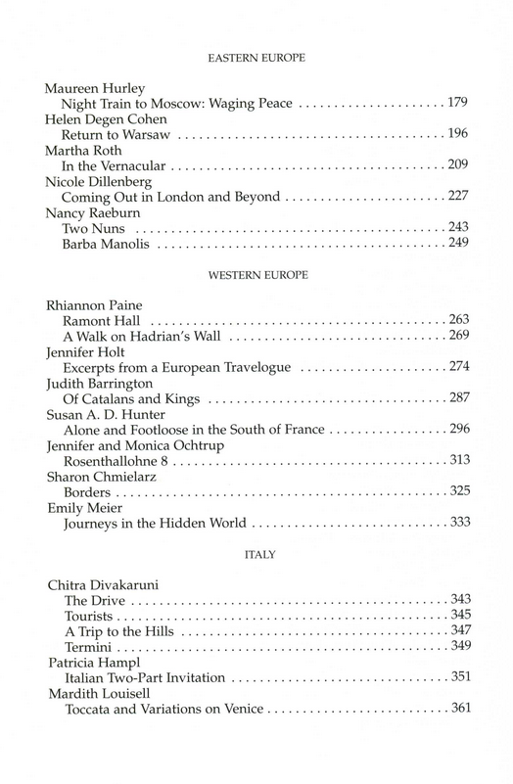
Notes:
Travel writing

Slide 77
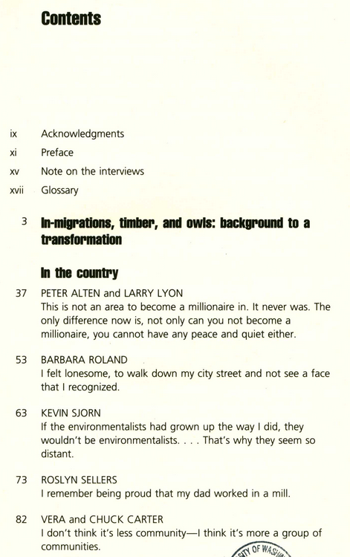
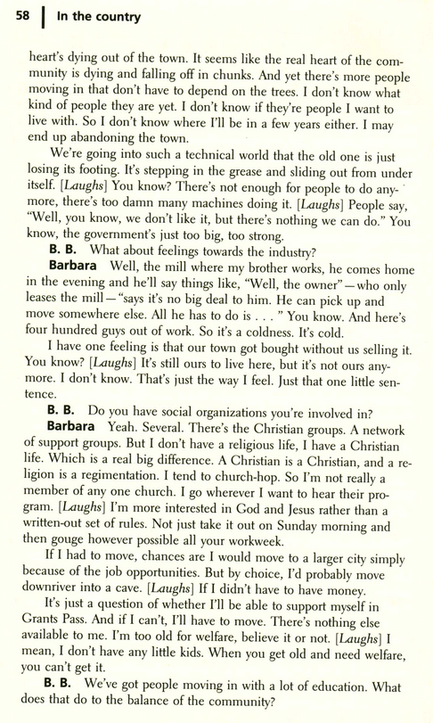
Notes:
Interviews

Slide 78
Literature Terms

Slide 79
Background Information
ALA ALCTS Subject Analysis Committee Subcommittee on Genre/Form Implementation Working Group on LCGFT Literature Terms developed initial list of terms
The WG initially looked at literature terms in LCSH, but they did not limit themselves to that; many new terms that aren’t in LCSH were proposed
Literature is the top term. Terms mostly fall under five main forms:
Comics (Graphic works)
Drama
Fiction
Folk literature
Poetry

Slide 80
Background Information
Explicit aspects like audience, creator characteristics, place of origin, language, and time period of creation that are often included in LCSH were out of scope for LCGFT if they are explicit in the term, so you will not find terms like these from LCSH: Children’s poetry; Buddhist stories; Christian fiction; Gay men’s writings; College prose; Byzantine literature; Literature, Medieval; Russian drama
However, when not explicit, terms may be in LCGFT, e.g.
Bible plays [specific religion is not explicit]
Chansons de geste [a medieval French genre]
Comedies of humours [an English 16th-17th century drama genre]
Jataka stories [Buddhist tales about the previous births of the Buddha]
Liras [a Spanish poetic form]
Muwashshaḥāt [an Arabic poetic form]
Mystery and miracle plays [a medieval religious drama genre]
Sagas [Icelandic prose narratives from 12th-14th centuries]

Slide 81
Background Information
For various reasons, LC rejected or deferred some terms in LCSH that the working group wanted to include in LCGFT, e.g. Chick lit; Complaint poetry; Dadaist poetry; Ecofiction; Fairy plays; Feminist fiction; Paranormal romance fiction; Patriotic poetry; Sea stories; Speculative fiction; Webcomics
LC also rejected some other proposed terms not in LCSH that the working group was hoping to get in LCGFT, e.g. Manga; Film tie-in fiction; Gentle reads
Some ethnic performing arts terms were deferred because they have non-literary aspects such as music and dance and LC wanted to consider how (or if) they fit into LCGFT, e.g. Kamishibai plays, Kōwaka plays, Topeng plays, Yakṣagāna plays
Notes:
Reasons for rejection include LC’s assertion that the term:
doesn’t represent a genre (Chick lit; Speculative fiction)
is a hybrid term (Fairy plays – use instead Fairy tales and Drama; Paranormal romance fiction – use instead Paranormal fiction and Romance fiction)
is subject focused and therefore not a genre (Complaint poetry; Ecofiction;, Sea stories)
is subjective and would require a value judgment (Feminist fiction; Patriotic poetry)
represents a style and LC isn’t yet sure whether style is eligible for LCGFT (Dadaist poetry)
is not work/expression attribute (Webcomics refers to a manifestation level characteristics)

Slide 82
Background Information
The Working Group on LCGFT Literature Terms will be following up with LC on deferred terms and has noted discrepancies between approved music terms approved and rejected or deferred literature terms:
Country gospel music Paranormal romance fiction
Country rock music Paranormal suspense fiction
Folk-rock music Romantic comedy plays
Alma mater songs Complaint poetry
Campaign songs Ecofiction
Christmas music Revolutionary poetry
Sea shanties Sea stories
Notes:
The terms on the left are approved music terms, while the terms on the right were rejected. The first two sets of terms both represent “hybrid” genres. The second set have a subject-aspect that LC didn’t allow in the LCGFT terms.

Slide 83
Background Information
LC subject headings that are analogous to genre/form terms for literary works will remain valid because the subject headings should continue to be assigned to works about the literary genres and forms. Catalogers should continue to assign subject headings to works about literature according to the principles and guidelines contained in the Subject Headings Manual (SHM)
The SHM will be revised in spring 2015 to reflect new policies on assigning genre/form terms to works of literature. Until the documentation is complete, PSD recommends that libraries wishing to implement the genre/form terms assign subject headings according to the policies in the SHM, along with the new genre/form terms
LC has not yet determined when it will implement the literature genre/form terms in new cataloging

Slide 84
Monthly List 2015-15
In March 2015, LC was supposed to approve about 400 terms for literary works. Due to workload issues, the terms still had not yet been approved in April 2015.
Many have corresponding headings in LCSH, but the LCGFT headings may not be identical. For example:
LCSH: Adventure stories LCSH: Motion picture plays LCSH: Horror comic books, strips, etc.
LCGFT: Adventure fiction LCGFT: Screenplays LCGFT: Horror comics
LCSH: Comic books, strips, etc. LCSH: Nonfiction novel LCSH: Gothic fiction (Literary genre)
LCGFT: Comics (Graphic works) LCGFT: Nonfiction novels LCGFT: Gothic fiction
LCSH: Horror tales LCSH: Moralities LCSH: Spy stories
LCGFT: Horror fiction LCGFT: Morality plays LCGFT: Spy fiction
LCSH: Plot-your-own stories LCSH: Comedy LCSH: Tragedy
LCGFT: Choose-your-own stories LCGFT: Comedy plays LCSH: Tragedies
LCSH: Mysteries and miracle-plays LCSH: Magic realism (Literature) LCSH: Suspense fiction
LCGFT: Mystery and miracle plays LCGFT: Magic realist fiction LCGFT: Suspense fiction and Thrillers (Fiction)
Notes:
All LCGFT terms are in the plural form, unlike some LCSH headings.
Workload issues has prevented LC PSD from approving the literature terms as expected in March 2015. They are expected later in spring 2015.

Slide 85
Sample proposed headings, A-Y (no Z yet)
Abecedariuses
Allegories
Apocalyptic comics
Autobiographical fiction
Bible fiction
Cell phone novels
Detective and mystery
fiction
Dystopian fiction
Educational comics
Fables
Fan fiction
Folk tales
Fotonovelas
Haiku
Humorous comics
Kabuki plays
Laudatory poetry
Legal drama
Legends
Love poetry
Magic realist fiction
Medical fiction
Monologues
Noir comics
Nonfiction comics
Nonsense verse
Novels of manners
Nursery rhymes
One-act plays
Pageants
Parables
Paranormal fiction
Parodies (Literature)
Picaresque fiction
Protest poetry
Puppet plays
Quatrains
Religious poetry
Road fiction
Robinsonades
Romance fiction
Romans à clef
Satires (Literature)
Sentimental comedies
Society verse
Space operas (Fiction)
Spoken word poetry
Sports comics
Steampunk fiction
Stories in rhyme
Superhero comics
Tall tales
Ten-minute plays
Thrillers (Fiction)
Tijuana bibles
Time-travel fiction
True crime comics
Urban fiction
Yue fu
Notes:
Yue fu: This heading is used as a genre/form heading for Chinese poems derived from folk songs.

Slide 86
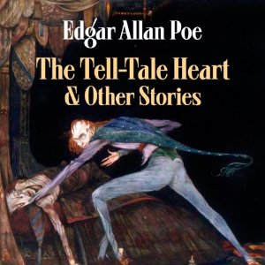
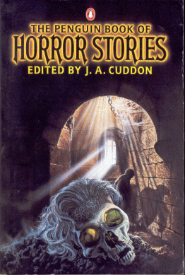
Reminder: Assign to both individual works and compilations by one or multiple authors
655 _7 Horror fiction. $2 lcgft 655 _7 Horror fiction. $2 lcgft 655 _7 Horror fiction. $2 lcgft
655 _7 Short stories. $2 lcgft 655 _7 Short stories. $2 lcgft 655 _7 Short stories. $2 lcgft
Notes:
Picture sources:
http://improbabilitydrive.deviantart.com/art/The-Tell-Tale-Heart-359554129
http://download-audiobooks.net/audiobooks/9263-edgar-allan-poes-the-tell-tale-heart-and-other-stories.html
https://vaultofevil.wordpress.com/2007/09/01/page/2/

Slide 87
Changes in Practice
For the time being, LC recommends assigning subjects as you do now, according to policies in the Subject Headings Manual
In addition, assign LCGFT literature terms both to individual works and compilations
Consider also adding audience and creator/contributor aspects in 385 and 386

Slide 88
Examples
245 04 The greatest Russian stories of crime and suspense / $c edited by Otto Penzler.
386 __ $n nat $a Russians $2 lcsh
650 _0 Detective and mystery stories, Russian $v Translations into English.
650 _0 Suspense fiction, Russian $v Translations into English.
650 _0 Short stories, Russian $v Translations into English.
655 _7 Detective and mystery fiction. $2 lcgft
655 _7 Suspense fiction. $2 lcgft
655 _7 Short stories. $2 lcgft

Slide 89
Examples
245 04 The Oxford anthology of African-American poetry / $c edited by Arnold Rampersad ; associate editor, Hilary Herbold.
386 __ $n eth $a African Americans $2 lcsh
386 __ $n nat $a Americans $2 lcsh
650 _0 American poetry $x African American authors.
650 _0 African Americans $v Poetry.
655 _7 Poetry. $2 lcgft

Slide 90
Examples
245 04 Night is gone, day is still coming : $b stories and poems by American Indian teens and young adults / $c edited by Annette Piña Ochoa, Betsy Franco, and Traci L. Gourdine.
386 __ $n eth $a American Indians $2 ericd
386 __ $n eth $a Indians of North America $2 lcsh
386 __ $n nat $a Americans $2 lcsh
386 __ $n age $a Teenagers $a Young adults $2 lcsh
520 __ A collection of poetry and prose by fifty-eight young American Indian writers, ages eleven to
twenty-two.
650 _0 American literature $x Indian authors.
650 _0 Indians of North America $v Literary collections.
650 _0 Indian teenagers $v Literary collections.
650 _0 Indian youth $v Literary collections.
650 _0 American literature $y 21st century.
650 _0 Teenagers' writings, American.
650 _0 Youths' writings, American.
655 _7 Short stories. $2 lcgft
655 _7 Poetry. $2 lcgft
and/or

Slide 91
Examples
245 00 Let’s hear it : $b stories by Texas women writers / $c edited by Sylvia Ann Grider and Lou Halsell Rodenberger.
370 __ $g Texas $2 naf COMING SOON
386 __ $n gdr $a Women $2 lcsh
386 __ $n nat $a Americans $2 lcsh
386 __ $n nat $a Texans $2 lcdgt COMING SOON
650 _0 Short stories, American $z Texas.
651 _0 Texas $x Social life and customs $v Fiction.
650 _0 American fiction $x Women authors.
650 _0 Women $z Texas $v Fiction.
655 _7 Short stories. $2 lcgft
Notes:
The 370 field was recently added to the MARC bibliographic format with three subfields:
$c - Associated country (R)
$f - Other associated place (R)
$g - Place of origin of work (R)
It is expected that the new LCDGT vocabulary will include terms for persons from a particular state, province, and region, as well as nationality. In the interim, you could give an uncontrolled term if there is no controlled vocabulary that includes demonyms for these places.

Slide 92
Examples
245 00 10 by 10 : $b ten ten-minute plays by ten leading playwrights for young audiences, each inspired by one of the Ten commandments / $c edited by Jeff Gottesfeld.
385 __ $n age $a Teenagers $2 lcsh
386 __ $n nat $a Americans $2 lcsh
650 _0 Young adult drama, American.
650 _0 Ten-minute plays, American.
650 _0 Teenagers $v Juvenile drama.
630 00 Ten commandments $v Juvenile drama.
655 _7 Ten-minute plays. $2 lcgft

Slide 93
Examples
100 1_ Lindgren, Astrid, $d 1907-2002, $e author.
240 10 Pippi Långstrump. $l English
245 10 Pippi Longstocking / $c Astrid Lindgren ; translated from the Swedish by Florence Lamborn ; illustrated by Louis S. Glanzman.
385 __ $n age $a Children $2 lcsh
386 __ $n nat $a Swedes $2 lcsh
386 __ $n gdr $a Women $2 lcsh
600 10 Longstocking, Pippi $v Juvenile fiction.
651 _0 Sweden $v Juvenile fiction.
600 11 Longstocking, Pippi $v Fiction.
651 _1 Sweden $v Fiction.
650 _1 Humorous stories.
655 _7 Humorous fiction. $2 lcgft
Notes:
So far the examples all were of compilations. However, the same practices can be applied to individual works and expressions.

Slide 94
Exercise
Based on the following LCSH headings, what would you put in 385/386 and 655?
650 _0 American literature $x Chinese American authors.
650 _0 Children of Holocaust survivors, Writings of.
650 _0 Young adult fiction, American $z Oregon $z Portland.
650 _0 Canadian poetry $x Jewish authors $v Periodicals.
650 _0 Canadian poetry $x Women authors $v Periodicals.
650 _0 Children’s stories, American.
650 _0 American fiction $x Catholic authors.
650 _0 High school students’ writings, American.
650 _0 Teenagers' writings, American.
Notes:
American literature $x Chinese American authors:
386 $n nat $a Americans
386 $n eth $a Chinese Americans
655 Literature or more specific terms such as Essays, Poetry, Short stories, etc., if the collection consists of just a few specific forms
Children of Holocaust survivors, Writings of
386 Children of Holocaust survivors
655 Literature or more specific terms such as Essays, Poetry, Short stories, etc., if the collection consists of just a few specific forms
Young adult fiction, American $z Oregon $z Portland
385 $n age $a Teenagers
386 $n nat $a Americans $a Oregonians perhaps Portlanders? (but does that mean people from Maine or Oregon?)
also eventually 370 $g Portland (Or.)
655 Short stories or perhaps Fiction
Canadian poetry $x Jewish authors $v Periodicals.
Canadian poetry $x Women authors $v Periodicals.
386 $n nat $a Canadians
386 $n eth $a Jews
386 $n rel $a Jews
386 $n gdr $a Women
655 Poetry
655 Periodicals or Serial publications
Children’s stories, American.
American fiction $x Catholic authors.
High school students’ writings, American.
Teenagers' writings, American.
385 $n age $a Children
386 $n nat $a Americans
386 $n age $a Teenagers
386 $n rel $a Catholics
386 $n edu $a High school students
655 Short stories

Slide 95
Time Period of Creation
We know now what to do with audience, creator characteristics, place of origin. But what happens to the time aspect if we stop using LCSH to describe what something is?
650 _0 American poetry $y 20th century $v Periodicals.
650 _0 English drama $y 19th century.
650 _0 Children's literature, Medieval.
650 _0 Greek literature, Modern $y 1453-1800.
650 _0 Christian literature, Early.

Slide 96
Time Period of Creation: 046
046 – Special Coded Dates (R)
$k Beginning or single date created (NR)
$l Ending date created (NR)
$o Single or starting date for aggregated content (NR)
$p Ending date for aggregated content (NR)
$2 Source of date
Date and time are recorded according to Representations of Dates and Times (ISO
8601) unless subfield $2 specifies another date scheme.
yyyy yyyymmdd yyyy-mm
Notes:
ISO 8601 specifies that dates are recorded as yyyy, yyyymmdd, or yyyy-mm when only the month and year are known. Most of the time, this will be sufficient. The default in MARC is ISO 8601, so if you are following this scheme, you don’t need to use subfield $2.

Slide 97
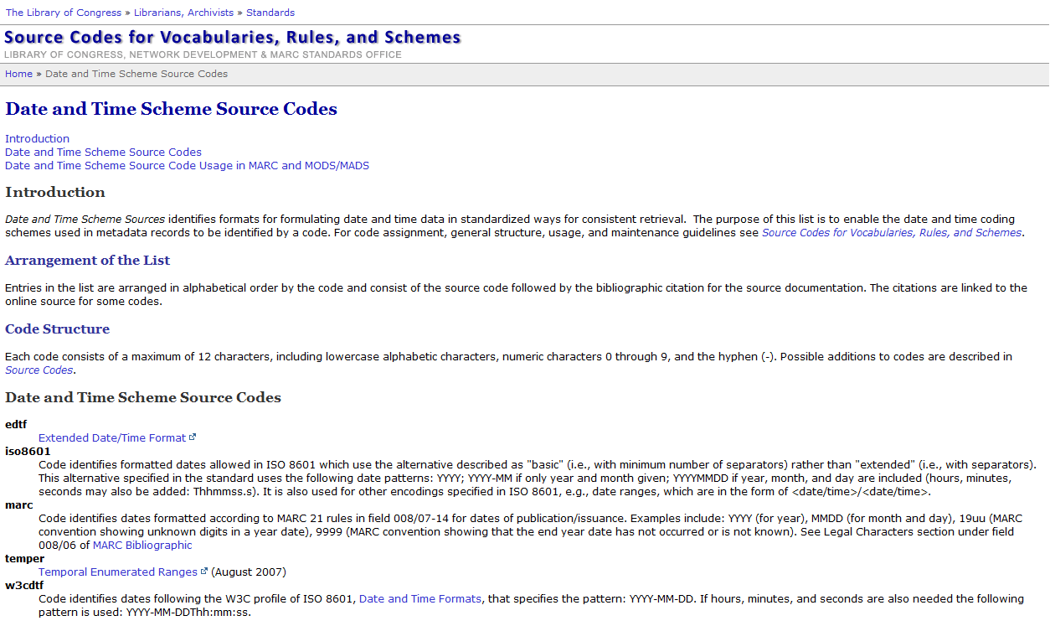
Notes:
Date and Time Scheme Source Codes
http://www.loc.gov/standards/sourcelist/date-time.html
If the ISO 8601 format is used, it’s not necessary to include 046 $2

Slide 98
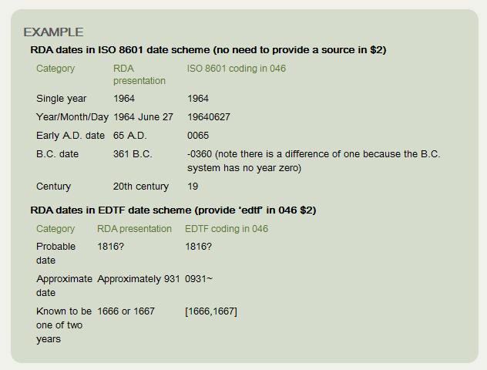
046 Coding Guidance
DCM Z1 046: http://www.loc.gov/catdir/cpso/dcmz1.pdf
LC-PCC PS for 9.3.1.3: http://access.rdatoolkit.org/lcpschp9_lcps9-104.html
Notes:
DCM Z1 046: When supplying dates in field 046, use ISO 8601 and supply dates using the pattern yyyy, yyyymmdd or yyyy-mm. For probable, uncertain, and approximated dates use the Extended Date Time Format (EDTF) schema, specifying that source in subfield $2 (edtf). See date table in LCPS 9.3.1.3.

Slide 99
Time Period of Creation: 046
046 __ $k 2013
130 0_ Frozen (Motion picture : 2013 : Buck and Lee)
245 10 Frozen / $c Walt Disney Animation Studios ; directed by Chris Buck, Jennifer Lee ; produced by Peter Del Vecho ; executive producer, John Lasseter ; screenplay by Jennifer Lee ; story by Chris Buck, Jennifer Lee, Shane Morris.
046 __ $k 2011
100 1_ James, E. L., $e author.
245 10 Fifty shades of Grey / $c E.L. James.
250 __ First Vintage Books edition.
264 _1 New York : $b Vintage Books, , a division of Random House, Inc., $c 2012.
264 _4 $c ©2011

Slide 100
Time Period of Creation: 046
046 __ $k 1837 $l 1839
100 1_ Dickens, Charles, $d 1812-1870, $e author.
240 10 Oliver Twist
245 10 Oliver Twist, or, The parish boy's progress / $c Charles Dickens ; edited with an introduction and notes by Philip Horne.
264 _1 Minneapolis : $b First Avenue Editions, $c [2015]
264 _4 $c ©2015
Notes:
Oliver Twist was originally published in serial installments between February 1837 and April 1839.

Slide 101
Time Period of Creation: 046
046 __ $k 2013 $o 1830 $p 1930
245 00 Deaf American prose 1830-1930 / $c Jennifer L. Nelson and Kristen C. Harmon, editors.
264 _1 Washington, DC : $b Gallaudet University Press, $c 2013.
046 __ $o 1801 $p 1900 or perhaps $o 18
245 00 Nineteenth-century British drama : $b an anthology of representative plays / $c edited by Leonard R.N. Ashley.
264 _1 Lanham, MD : $b University Press of America, $c [1989]
046 __ $o 1987 $p 9999 $2 marc
245 00 The best American poetry.
260 __ New York, N.Y. : $b Charles Scribner's Sons, $c c1988-
310 __ Annual
362 0_ 1988-
Notes:
In the first example, both the date of creation of the aggregate work and the dates of creation of individual works in the aggregation are coded in 046. In most cases, only the dates of the works in the compilation will be of interest. The second example shows that only $o and $p have been recorded for a compilation.
The best American poetry is an annual anthology of poems from the previous calendar year. In this case, the $2 code “marc” identifies dates formatted according to MARC 21 rules in field 008/07-14 for dates of publication/issuance. Examples include: YYYY (for year), MMDD (for month and day), 19uu (MARC convention showing unknown digits in a year date), 9999 (MARC convention showing that the end year date has not occurred or is not known). Without the $2 code “marc”, 9999 in $p would literally mean the year nine thousand nine hundred ninety-nine.

Slide 102
Time Period of Creation: 388
NOT YET IMPLEMENTED
388 - Time Period of Creation (R)
First indicator: Type of time period # - No information provided 1 - Creation of work (or of the components of a compilation considered collectively) 2 - Creation of aggregate work
$a - Time period of creation term (R)
$0 - Authority record control number or standard number (R)
$2 - Source of term (NR)
$3 - Materials specified (NR)
Notes:
388 Field Definition: The time period of creation or origin of the work or expression (including aggregate works), or of the works or expressions contained in an aggregation.
First indicator value 1: The time period of creation or origin of the work/expression, or of the components of an aggregate work/expression considered collectively.
First indicator value 2: The time period of creation or origin of an aggregate work/expression.

Slide 103
Time Period of Creation: 388
046 __ $k 2013 $o 1830 $p 1930
245 00 Deaf American prose 1830-1930 / $c Jennifer L. Nelson and Kristen C. Harmon, editors.
264 _1 Washington, DC : $b Gallaudet University Press, $c 2013.
388 1_ Nineteenth century $2 lcsh
388 1_ Twentieth century $2 lcsh
388 1_ 1830 - 1930 $2 fast
046 __ $o 1801 $p 1900
245 00 Nineteenth-century British drama : $b an anthology of representative plays / $c edited by Leonard R.N. Ashley.
388 1_ Nineteenth century $2 lcsh
388 1_ 1800 - 1899 $2 fast
Notes:
In the first example, if the creation date of the compilation is important, a 388 could be given for it as well, using first indicator value 2:
388 2_ 2013 $2 fast
388 2_ Two thousand tens $2 lcsh [actually, this decade isn’t yet established in LCSH]

Slide 104
Time Period of Creation: 388
046 __ $o 1300 $p 1500
245 03 An anthology of medieval love debate poetry / $c translated and edited by Barbara K. Altmann and R. Barton Palmer.
264 _1 Gainesville : $b University Press of Florida, $c [2006]
388 1_ Middle Ages $2 lcsh
650 _0 French poetry $y To 1500 $v Translations into English.
650 _0 Debate poetry, French $v Translations into English.
650 _0 Love poetry, French $v Translations into English.
650 _0 Debate poetry, English (Middle) $v Translations into English.
650 _0 Love poetry, English (Middle) $v Translations into English.
655 _7 Debate poetry. $2 lcgft
655 _7 Love poetry. $2 lcgft
Notes:
The authors included in the anthology are all from the 14th and 15th centuries, so the 046 has been coded with a range of 1300-1500. If the exact dates of each of the five works in the collection were known, a more precise range could be given in the 046.
The tradition of love debate poetry : an introduction -- Le jugement dou roy de Behaingne (The judgment of the King of Bohemia) ; Le jugement dou roy de Navarre (The judgment of the King of Navarre) / Guillaume de Machaut -- The legend of good women / Geoffrey Chaucer -- Le debat de deux amans (The debate of two lovers) / Christine de Pizan -- Le livre des quatre dames (The book of the four ladies) / Alain Chartier.
Birth/death dates:
Guillaume de Machaut: 1300?-1377
Geoffrey Chaucer: ca. 1342-1400
Christine de Pizan: ca. 1364-1430
Alain Chartier: ca. 1385-ca. 1433

Slide 105
Summary
Assign LCGFT in field 655 in addition to whatever subject headings you assign in 600-651. When should you start? Now!
Consider joining SACO if you think you might want to make proposals for additional terms to include in LCGFT or LCDGT
For now, if using LCSH, continue to follow existing policies found in the Subject Headings Manual

Slide 106
Summary
Consider adding 385 for audience and 386 for creator/contributor characteristics
Decide what controlled vocabularies you will use until LCDGT is available
Can you configure your ILS or discovery system to take advantage of this data?
At the very least, think about how we will keep this information once we stop using LCSH terms/strings that indicate audience or creator when we are cataloging something that is an example of the genre/form and not about it
Consider adding 046 for time period of creation and when it would be needed or useful
Always add it? Only when time period of creation is part of the LCSH term/string? When it’s in the title? For individual works as well as for compilations? For certain kinds of materials or formats such as rare books or videos?
Can you configure your ILS or discovery system to take advantage of this data?
Notes:
Second large bullet: When time period of creation is part of the LCSH string that we will eventually stop using? When it’s part of the title? Other circumstances? At University of Washington, media catalogers are now routinely adding the date of creation to video records for films and television programs.

